Slide 1
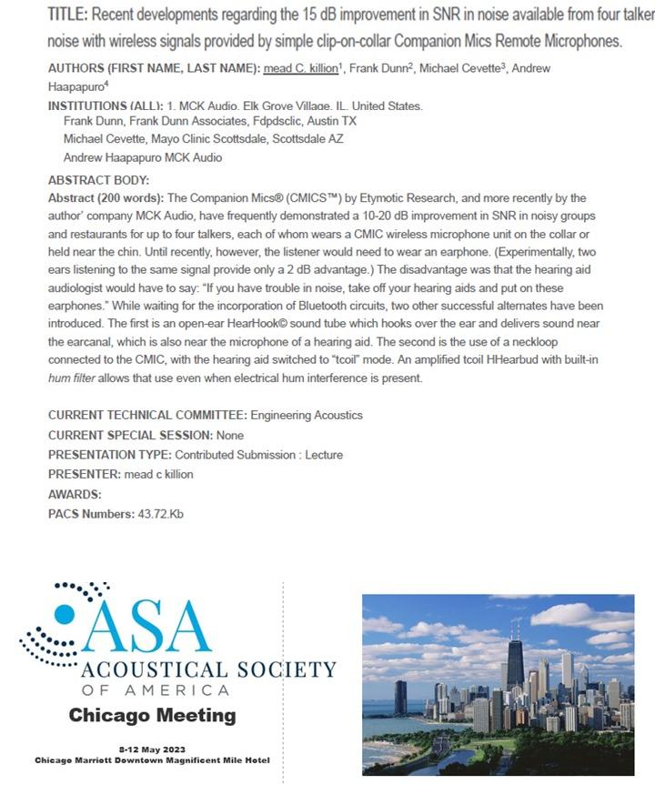
Printed Abstract for
Killion et al.
Companion Mics
Presentation
ASA, Chicago
May 8, 2023

Slide 2
ASA May 8, 2023 Chicago -- Slides
Title: New improvements to the latest 9-year-old Companion Mics system
Mead Killion MCK Audio, Inc.
OUTLINE
0. Background: The problem
Some 1 million hearing aid wearers have such a great loss of ability to
hear in noise that they can’t enjoy family dinners in noisy restaurants
1. The science behind our understanding of the problem
The Companion Mics solution: Four clip-on transmitting microphones each of which pick up the voice of talkers only 5-8 inches from their mouths,
giving a 15 to 20+ dB increase in Signal to Noise Ratio.
The four wearers hear each other like on a an old country party line.
3. Marketing problems and three trial solutions
4. Other product innovations

Slide 3
NORMAL
LOSS OF INNER HAIR CELLS
So many of the “audible” speech cues are
lost on the way to the brain.

Slide 5
Q: What happens if Backgound Noise masks 74% of the speech cues?
26 Dots left audible above noise:
Bell Labs AI = 26%
A: Surprisingly little with normal hearing: 96% of sentences can still be understood!

Slide 6
With Restaurant Noise
\/
Sentences
Words
Bell Labs AI in % (cf. Number of “Audible Dots”)

Slide 7
But with 8 or 10 dB SNR loss, those million hearing aid wearers are excluded from conversations in moderate restaurant noise levels

Slide 8
Fig 5. Bringing people back to normal ability to hear in noisy places. Three technologies make it possible for individuals with a mild to profound loss of the ability to understand speech in normally noisy situations.

Slide 9
The 26-year-old history of Companion Mics
Companion Mic
(Wireless)
Array Mic
D-Mic (FIRST ORDER)
Success! Used in the five Otology Surgical Suites in Mayo Clinic Scottsdale

Slide 10
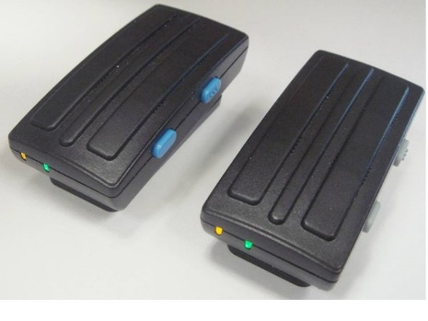
Introduced in 1996
⬅ Collar 20 dB
As if you friend was talking close to your ear, not across the table!
⬅ Shirt Clip 15 dB
Companion
Mics
⬅ Collar
⬅ Shirt Clip

Slide 11
A few years later we ran a wonderful ad in HRev
Sales did not cover the cost
of the ad.
Perhaps a simple bar graph would have made a been better ad.
In my enthusiasm, I’m afraid
that I forgot that:
“take off your hearing aids” would never be welcome advice.

Slide 12
In talking this over with Mayo’s
Mike Cevette, we almost simultaneously
said: Why don’t we leave the
Hearing Aids on and bring the sound
to the ITE hearing aid microphone, or
the open EAR,thru a simple open tube??
The HearHook was born
The Companion Mics with the new
HearHook sound tube were an immediate
success in Mayo surgery.

Slide 13
IT WORKS!
13 dB
20 dB
Sealed Earphones
Talker 6 feet away
Single open-ear HearHook
Clear speech
At 70 dB noise.
Single Open-ear HearHook
Percentage Words Correct in 60-85 dBA Noise Levels
Talker 6 feet away
OK with 60 dB noise level and open ears.
Open-ears
Talker 6 feet away
Impossible with 70 dB noise level and open ears
Sealed-ear Earphones
.7

Slide 14
We ran two full-page ads in
Hearing Review
-- BUT --
The resulting sales
still did not cover the cost of the ads.

Slide 15
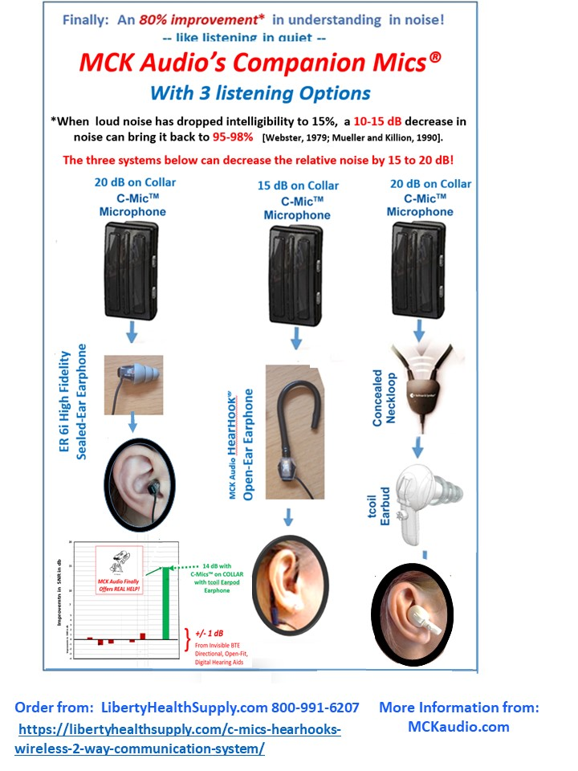
So we pursued other, less
expensive, approaches.

Slide 16
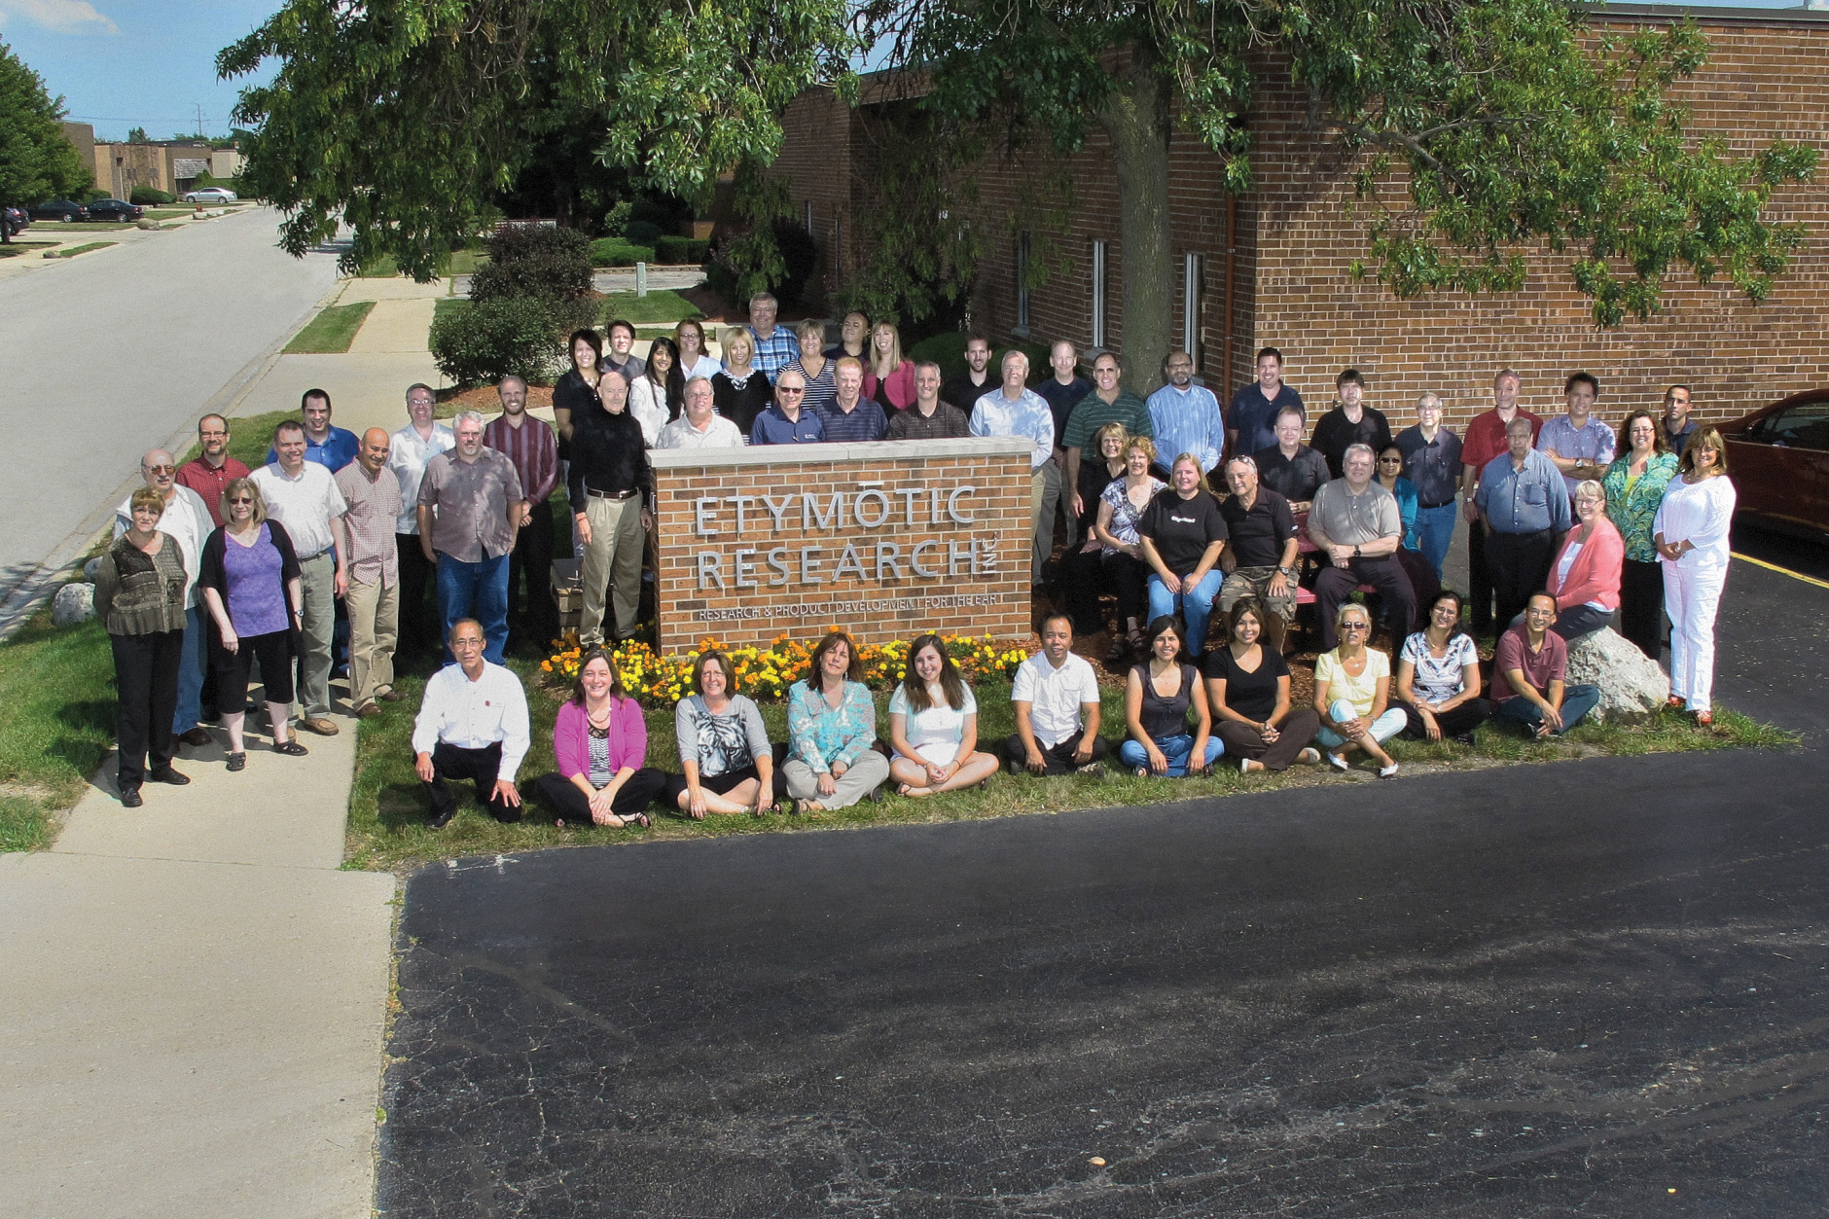
Even though Etymotic Research was a much larger company back then, with literally 45 successful innovative products families since 1953 (even a portable noise dosimeter) --- we were not successful with the Companion Mics in reaching
even a small fraction of the 700,000 hearing aid wearers
who have greater than SNR loss in the U.S.
Return to CM story after talking about other products we developed

Slide 17
I have recently been reminded that three of our my most successful previous products
took 11, 20, and 25 years to bring to market! I budgeted for 2-3 years.

Slide 18
Finally, we have recently retooled the “Link-it” Array Mics, originally developed by Wim Soede and Roland Horsten 20 years ago. They still the best we SNR increase we know of:
8+ dB for speech, and held out in front it can be 12-13 dB!
Point at a table in a noisy restaurant, you can hear them clearly
Point to another, and that one disappears and the new one is clearly heard.
An Astrophysicist friend who has several hearing aids and remote mics, said “WOW” when he heard this one.
He keeps calling to see how we are coming with it.
“We keep trying, but we need more than what I and
three part-time engineers can do!” (dr abonso)

Slide 19
We keep trying, but we need more than Dr Abonso
and three great part-time engineers can do!

