Slide 1
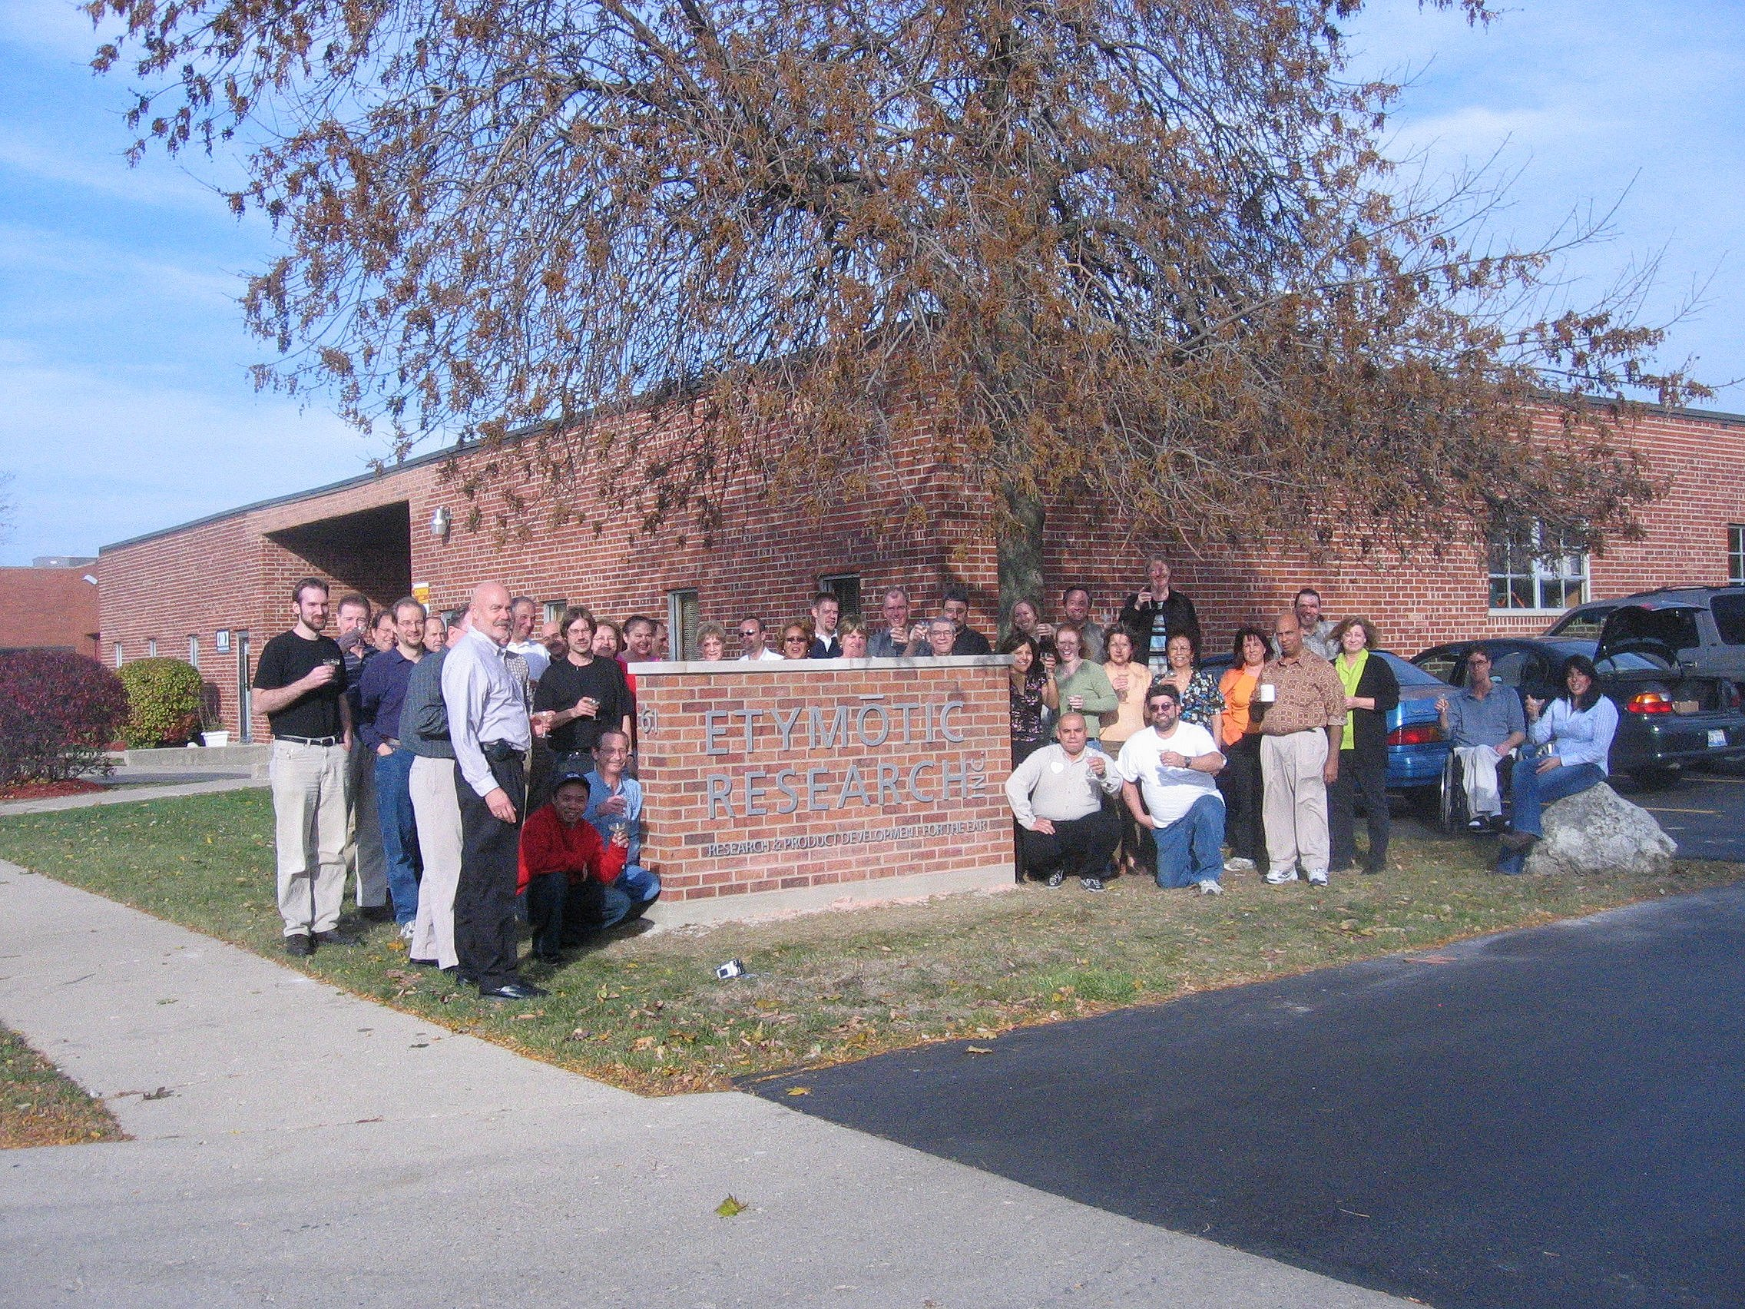

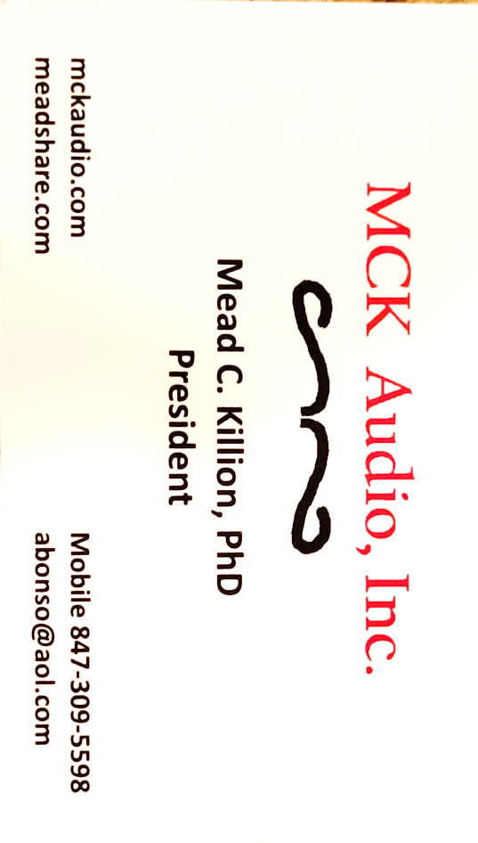
Greetings from cool and sunny Elk Grove Village, Illinois
Hear for a Lifetime
Mead Killion, PhD, ScD(hon)
Trustee, Vandercook College of Music
thru 2023

Slide 2
Etymotic Research, the company I founded
was devoted to developing products to:
Help those with hearing loss
Help prevent hearing loss
Help measure hearing
Help make listening more fun
In the last 33 years, Etymotic has produced:
110 U.S. Patents
85 Scientific Papers and 21 Book Chapters
and 30 generations of new products
Crain’s Chicago Business rated Etymotic in the top 25 of 400 Innovative companies in Chicago Area

Slide 3
After we sold Etymotic Research,
We started a new company,
MCK Audio
To pursue the goal of helping those with severe trouble
hearing in noise to hear as if in quiet.
We have submitted an SBIR research grant to
fund the technical problems in that goal.

Slide 4

Back to the main topic:
I Am a Musician Disclosure:
Mead Loves Music_April_2015-2.mp4

Slide 5
Two Main Topics
How we get hearing loss
How we can avoid hearing loss

Slide 6
The best paper title of this century (so far):
“Age Related Hearing Loss: Evidence of a Misspent Youth”
Kujawa and Liberman (2006)

Slide 7
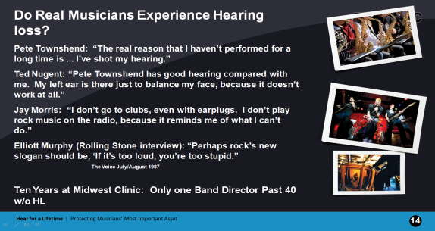

Slide 8
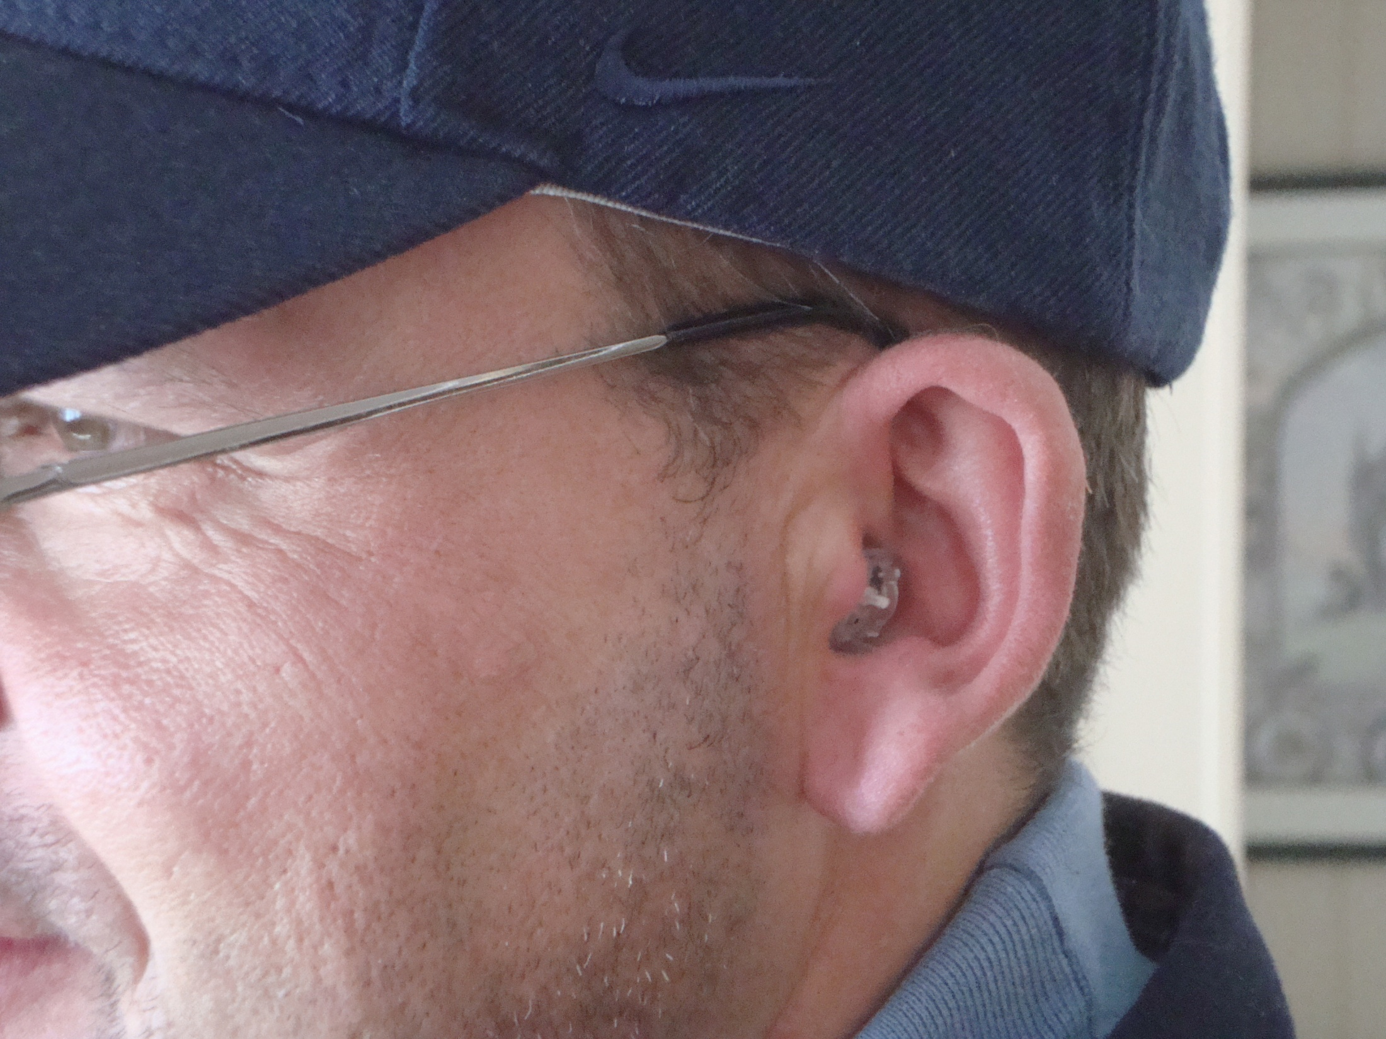
Permanent hearing loss can happen in a very short time.
Drummer for New Orleans band: Two hours to complete
loss of useful hearing in his left ear.
A friend ended up with a severe hearing loss in his left ear after a single firefight in Iraq with “5000 rounds of machine gun fire on my left side.”
Tossing Firecrackers in cars years ago in Nashville

Slide 9
More commonly, hearing loss accumulates over time
---
And it can start in school music programs

Slide 10
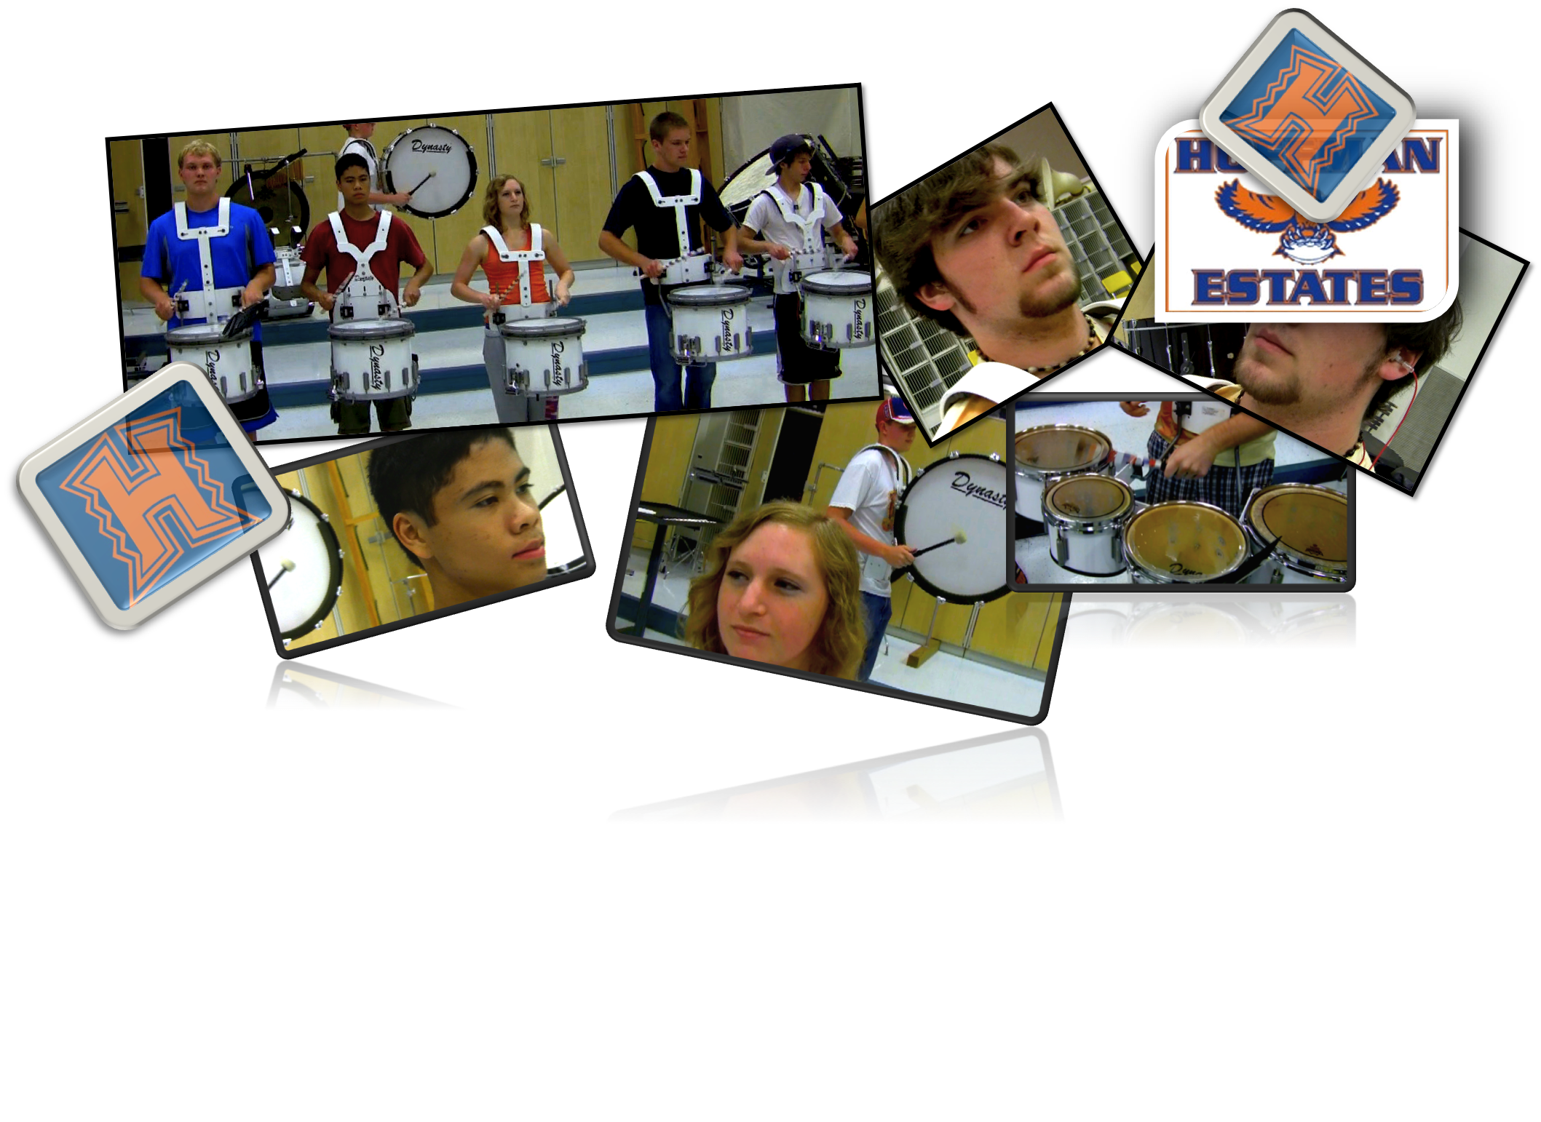
The First-Time Earplug Experience
Hoffman Estates High School Drumline
Notes:
10

Slide 11
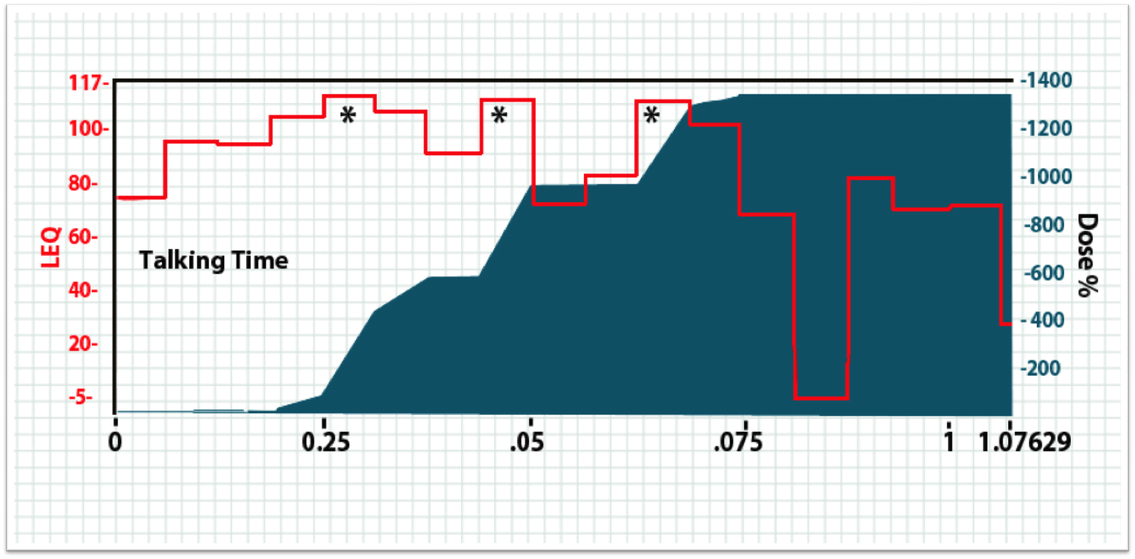
One Hour with a Drummer Rehearsing
Cadences typically last 4 minutes. | 1 Minute Safe> 12 Minutes Total or 12 Times (1200) Overdose

Slide 12
➔ In 12 years standing at the Etymotic Research booth at the Midwest Clinic, I have met only two band directors past the age of forty who did not have a hearing loss.

Slide 13

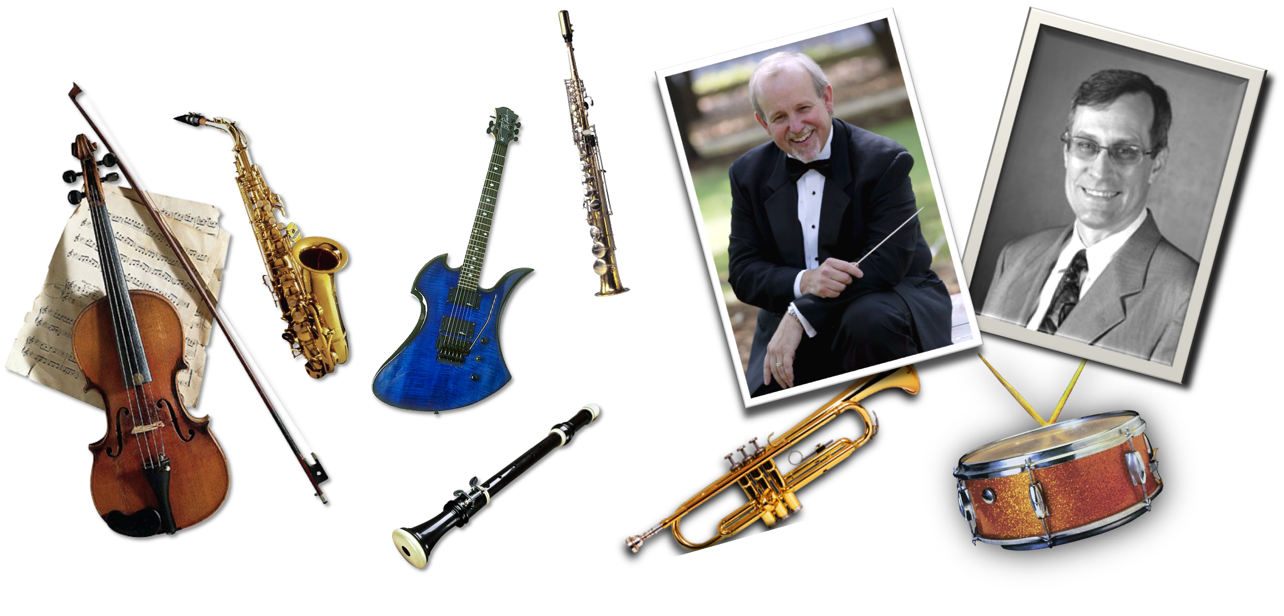
Chicago, IL
Many years ago, in preparation for this presentation back then, I had the privilege of taping Prof. Charles Menghini, who was president of Vandercook University at that time.
Hear for a Lifetime a (Dec. 5, 2009) - Large
Notes:
A few years ago, in preparation for this presentation, we had the privilege of taping Prof. Charles Menghini, president of Vandercook University, and Kevin Fetter, a percussion teacher there. What they had to say speaks for itself. 2:30

Slide 14
13
Go to Hear for a Lifetime Video
Charlie Menghini and Kevin Leper tell their stories
Mead and his Brother, Mechanisms of Hearing loss in Cochlea, and what it sounds like
Experiences of Hoffman Estates Drumline students, And what it sounds like
Ruben Gonzales CSO Violin Concertmaster and 4 K notch in left ear
More on cochlea distortion
More on HiFi Earplugs
Back to slides
d
Notes:
A few years ago, in preparation for this presentation, we had the privilege of taping Prof. Charles Menghini, president of Vandercook University, and Kevin Fetter, a percussion teacher there. What they had to say speaks for itself. 2:30

Slide 15
Speaking of virtuoso trumpet players, Charlie Geyer, former professor of music at Northwestern University, was 4th trumpet in the Chicago Symphony Orchestra for 12 years – sitting right next to the percussion section.
He told me (with permission to tell his story):
“It happens so slowly that you don’t notice it is happening until one day you discover you can’t carry on a conversation with the telephone on your right ear.”

Slide 16
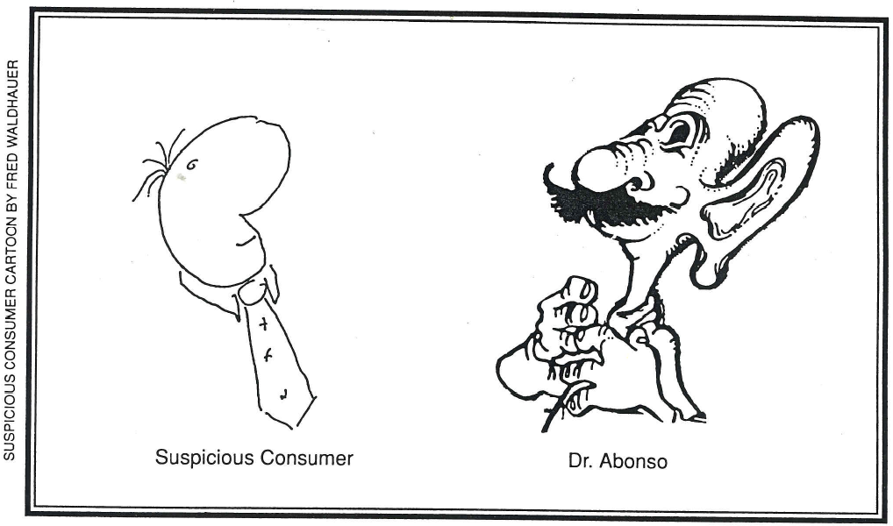
Q: But don’t my ears tell me when it is too loud??
A: Yes indeed – for the first few times loud sounds will be very uncomfortable.
Q: Then what happens to my safety warning signal?
Q: It becomes muted. There was a famous study of German factory workers in the 1970s
Notes:
There are extensive tables called Damage Risk Criteria which predict the amount of hearing loss to be expected from different amount of noise or music exposure. From the dosimeter readings we had from Ruben, we concluded that his left ear probably had the equivalent of 100 dBA exposure for 8 hours a day for 30 years.
The prediction for “tough” ears is shown by the green curve. Someone falling within the 10% most resistant to hearing damage might have a 25 dB loss which would probably not have been noticeable. The prediction for “weak” ears, on the other hand, is shown by the purple curve at the bottom. Someone with the 10% least resistant ears would have a severe hearing loss a 3 and 4 kHz. 4 kHz is the top not on the piano, but also contains many of the harmonics of music and speech sounds such as /th/ and /f/ used in the words that and fun as “that was fun.” Not to mention /s/ which is the most important sound in making distinctions in English.
Ruben either had average toughness ears, or we overestimated his lifelong dosage since the time we measured him he was practicing to play the Brahms Violin Concerto which has a murdureous triple stop triple forte section in the middle.
The point is that even a violin can cause hearing damage, especially if it is a powerful Bergonzi and you play it with your ear down almost against it as Ruben did.
The other point is that there is no way to predict in advance how tough your ears are, and so it wouldn’t hurt to assume they were not tough. The cost of assuming they are tough when they aren’t is obvious.

Slide 17
After a few years on the job, it doesn’t sound too loud anymore!
90 100 110 120 130 dBA SPL
My estimate of SPLs corresponding to Discomfort

Slide 18
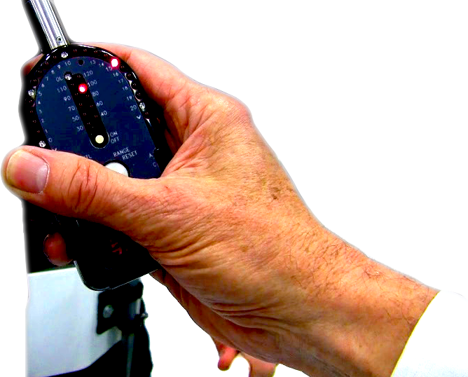
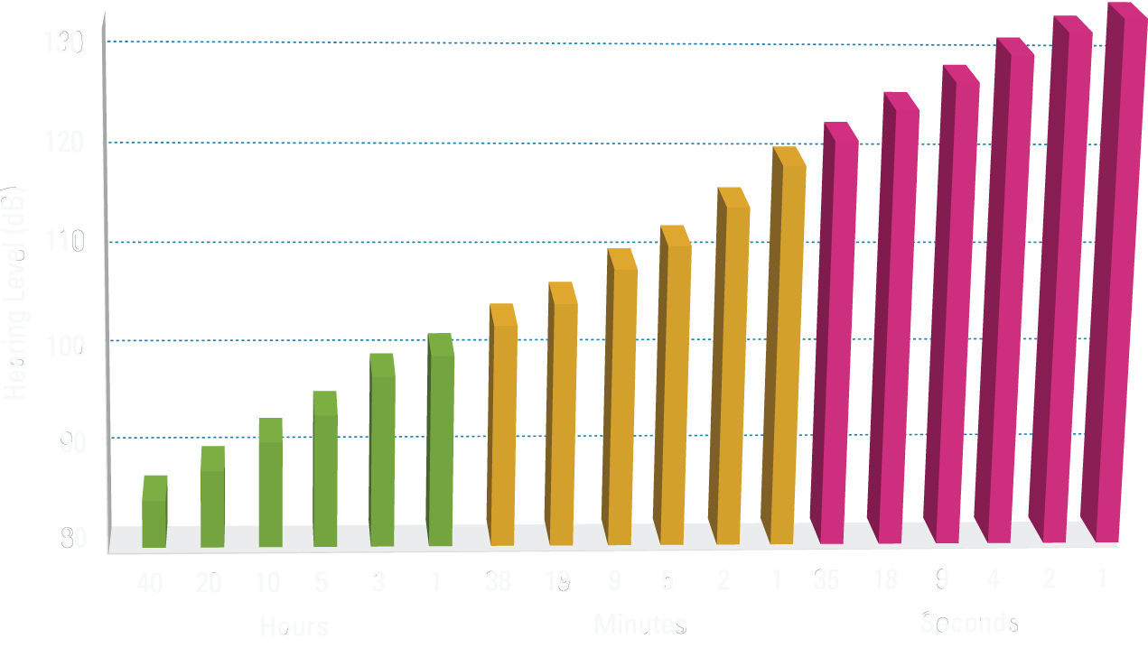
How do you know what’s safe?
100 + 15
=115 dB peak
Safe Weekly Allowable Sound Exposure
Marching band
Old chainsaw
Drumline rehearsal
Chicago blues bar
Major sporting event
Loud bar with band
Party with band
Notes:
The Chicago blues bars I have clocked come in at about 108, except when the soloist comes in at 112/114 dB. But even 108 is safe for about 9 min, so you don’t have time to drink your beer before you should get out of there, or more sensibly, put in some hearing protection.
Drumline rehearsals can reach 112 dB, which is safe for about 5 min a week. If you play every day, that means 1 minute per day. Does that mean that if you are on a drumline rehearsal for more than 5 minutes you will loose all your hearing? Of course not. but these guidelines do tell you how to hear for a lifetime.
18

Slide 19
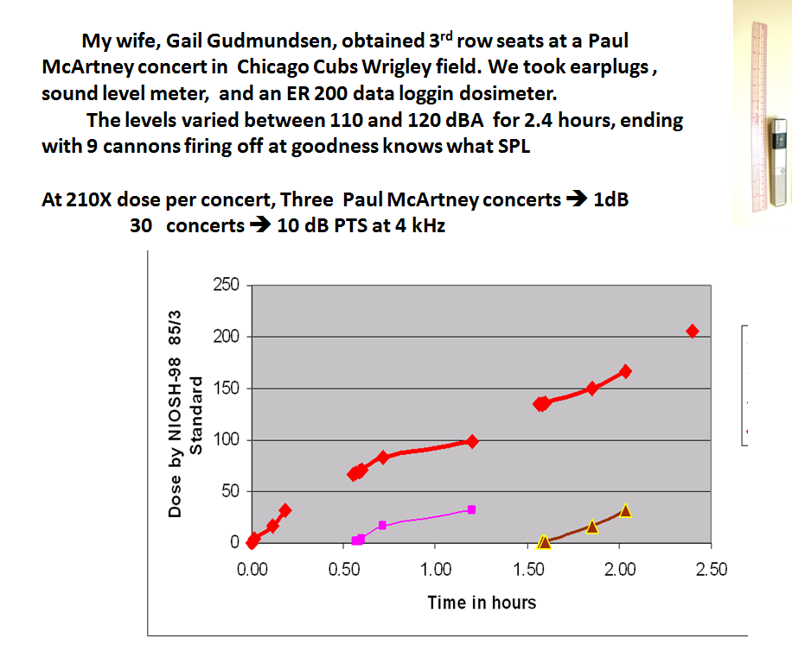
My wife Gail obtained 3rd row seats for us at a Paul McCartney concert in Chicago’s Wrigley field. We took a Sound Level meter, ER200 Dosimeter, and, of course, ER20 earplugs.
I measured 210 X the allowable does: In other words, 210 days of safe exposure (85 dBA for 8 hours) crammed into 2.4 hours!

Slide 20
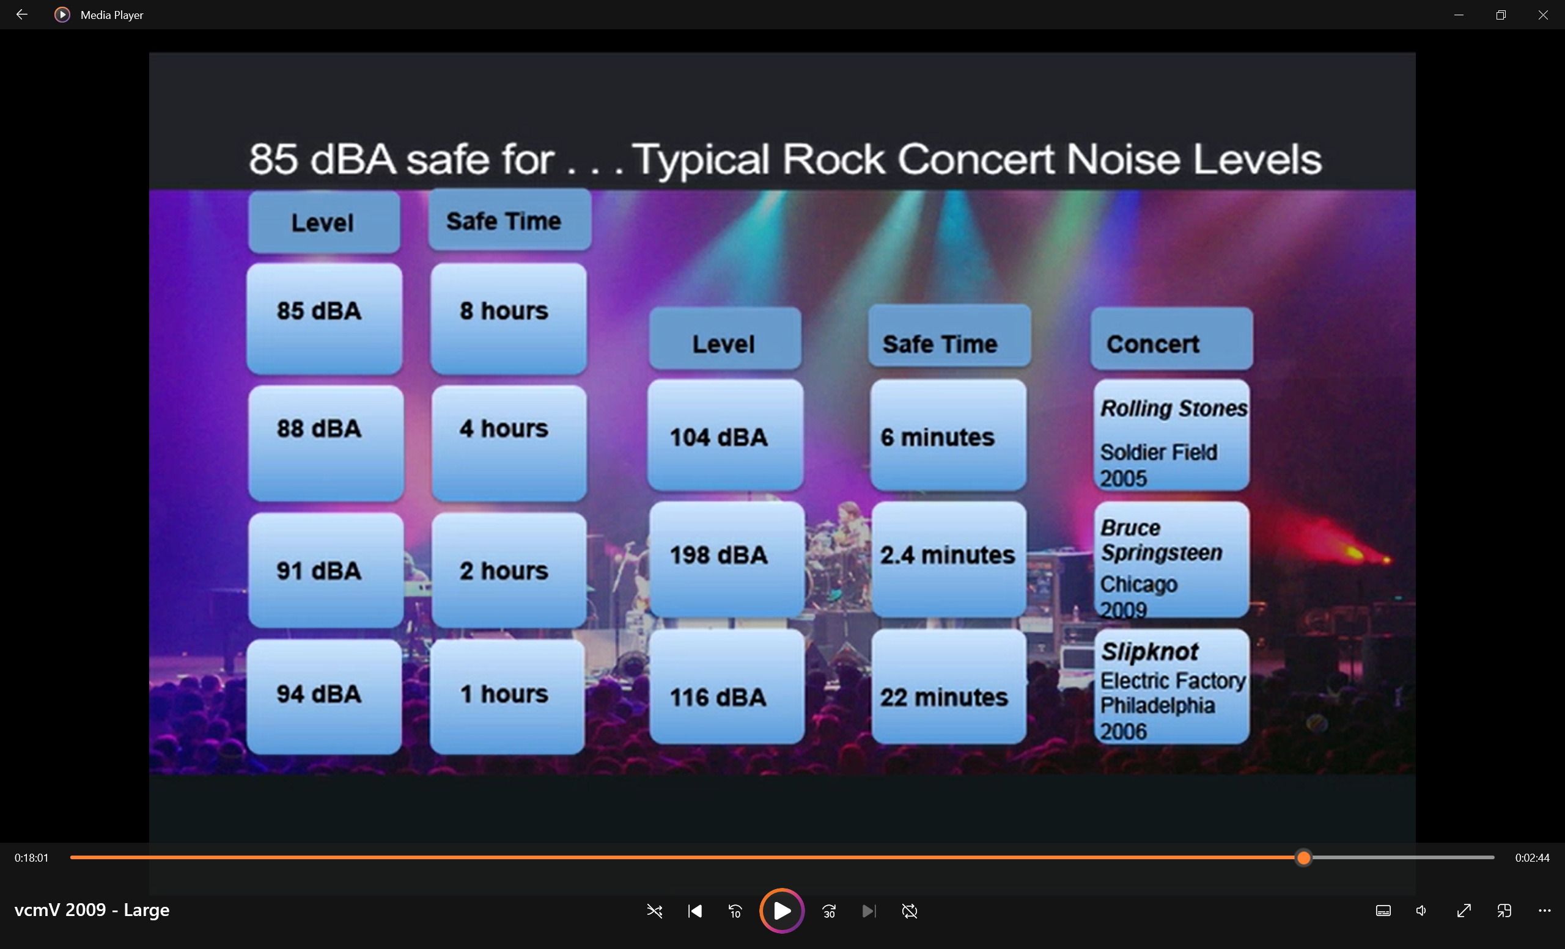
108 ! !

Slide 21
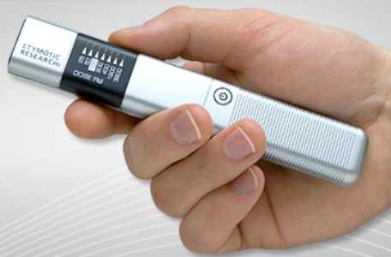
How can you know what is safe?
Personal Noise Dosimeter
Sound level meter
Notes:
The Chicago blues bars I have clocked come in at about 108, except when the soloist comes in at 112/114 dB. But even 108 is safe for about 9 min, so you don’t have time to drink your beer before you should get out of there, or more sensibly, put in some hearing protection.
Drumline rehearsals can reach 112 dB, which is safe for about 5 min a week. If you play every day, that means 1 minute per day. Does that mean that if you are on a drumline rehearsal for more than 5 minutes you will loose all your hearing? Of course not. but these guidelines do tell you how to hear for a lifetime.
21

Slide 22
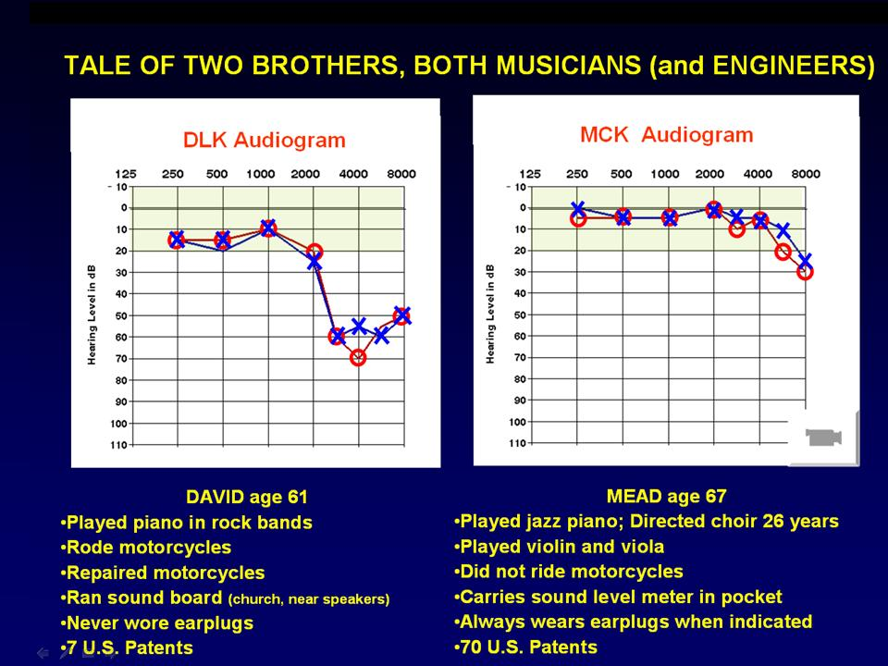

What happens when exceed the limits year after year?
Almost the identical audiogram of Prof. Menghini
(17 year ago)
(17 year ago)
(But his patents are worth $1 Billion)
(Old slide – Now 108 patents)

Slide 23
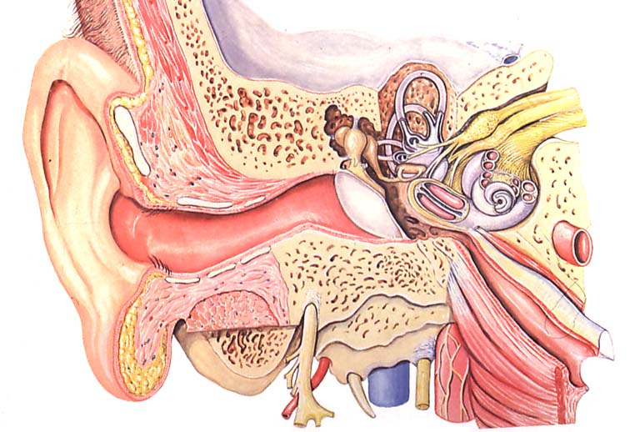
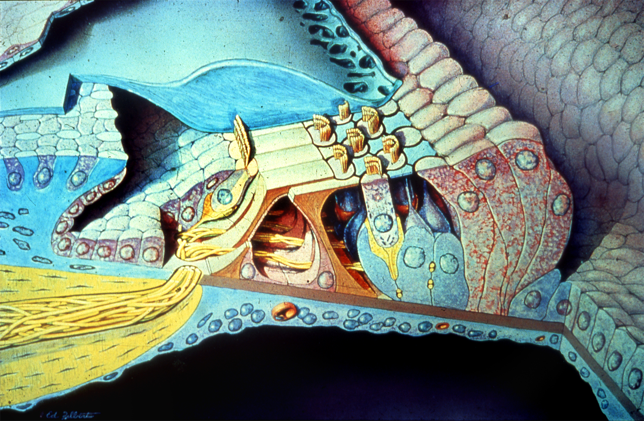
How We Hear
Notes:
23

Slide 24
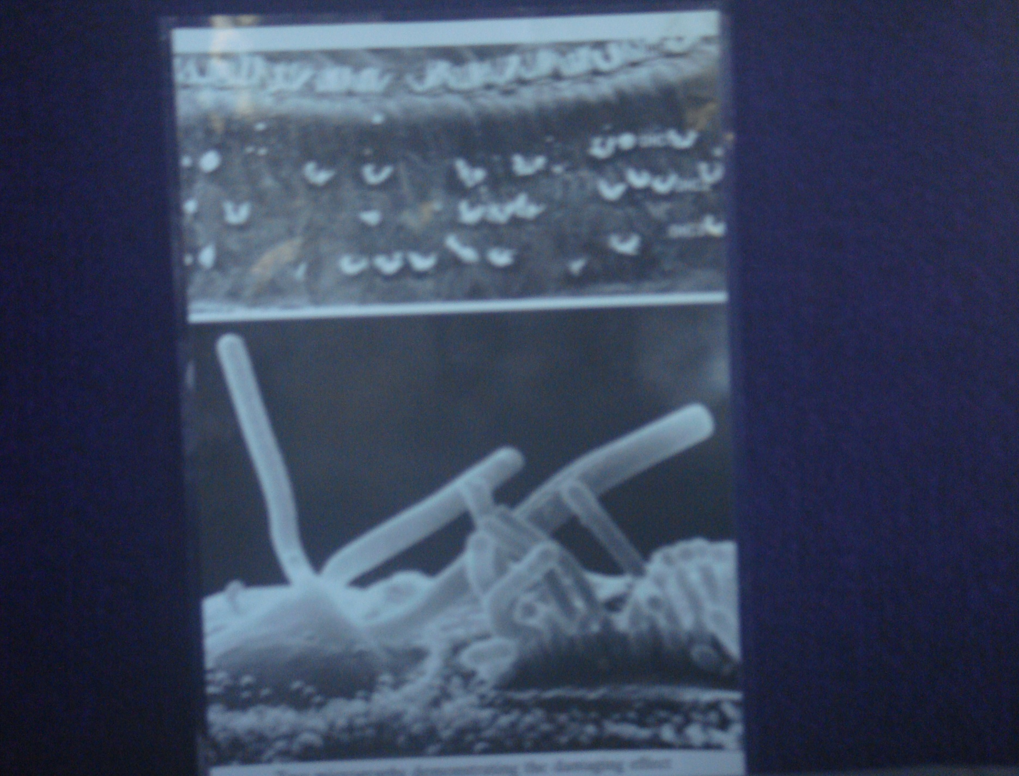
What happens to the tiny “hair cells” in the inner ear when they are exposed to those sound levels?
A: They turn to spaghetti!

Slide 25
A review:

Slide 26
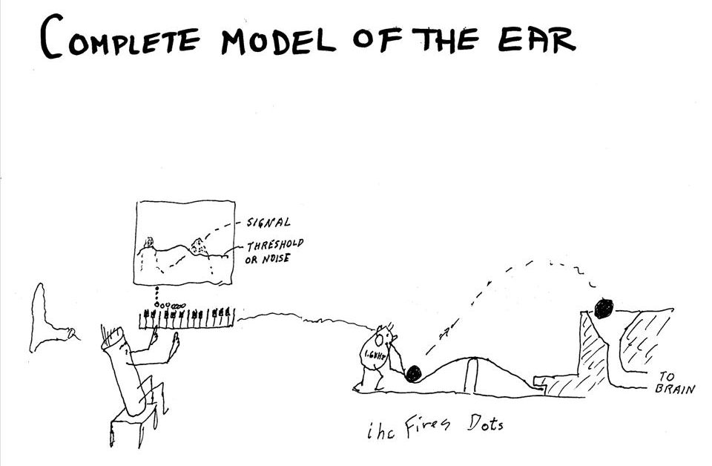

Slide 27
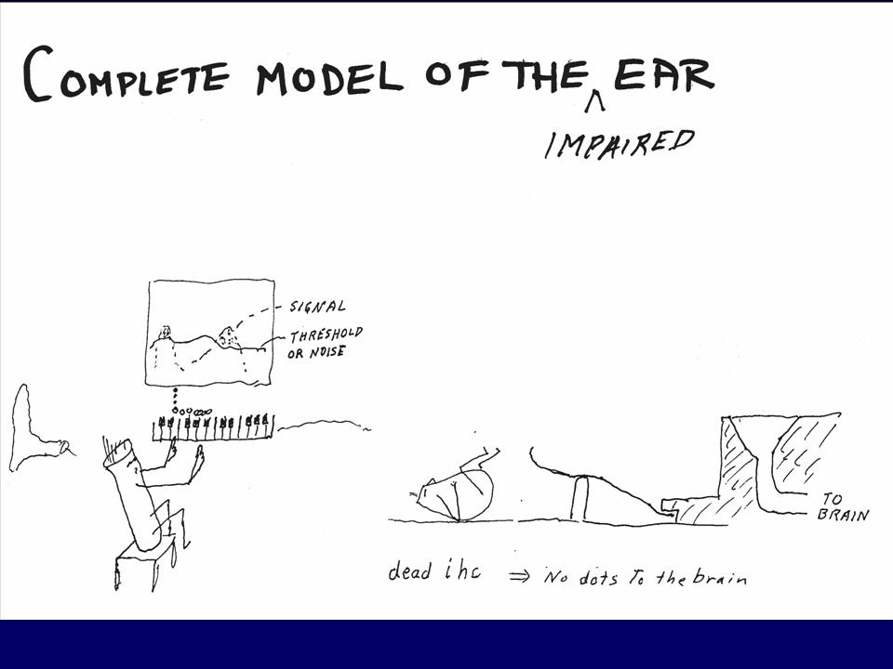

Slide 28
Q: Aren’t you being an alarmist? I know some musicians that have been around really loud sounds for many years and they still hear pretty well. What do you say about that?
A: The best answer came from the shipbuilders in WWII, down inside steel reverberation chambers pounding and scraping. Some came out after 30 years with profound hearing loss, others still had good hearing.
Notes:
There are extensive tables called Damage Risk Criteria which predict the amount of hearing loss to be expected from different amount of noise or music exposure. From the dosimeter readings we had from Ruben, we concluded that his left ear probably had the equivalent of 100 dBA exposure for 8 hours a day for 30 years.
The prediction for “tough” ears is shown by the green curve. Someone falling within the 10% most resistant to hearing damage might have a 25 dB loss which would probably not have been noticeable. The prediction for “weak” ears, on the other hand, is shown by the purple curve at the bottom. Someone with the 10% least resistant ears would have a severe hearing loss a 3 and 4 kHz. 4 kHz is the top not on the piano, but also contains many of the harmonics of music and speech sounds such as /th/ and /f/ used in the words that and fun as “that was fun.” Not to mention /s/ which is the most important sound in making distinctions in English.
Ruben either had average toughness ears, or we overestimated his lifelong dosage since the time we measured him he was practicing to play the Brahms Violin Concerto which has a murdureous triple stop triple forte section in the middle.
The point is that even a violin can cause hearing damage, especially if it is a powerful Bergonzi and you play it with your ear down almost against it as Ruben did.
The other point is that there is no way to predict in advance how tough your ears are, and so it wouldn’t hurt to assume they were not tough. The cost of assuming they are tough when they aren’t is obvious.

Slide 29
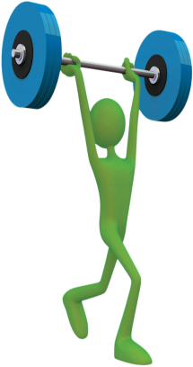
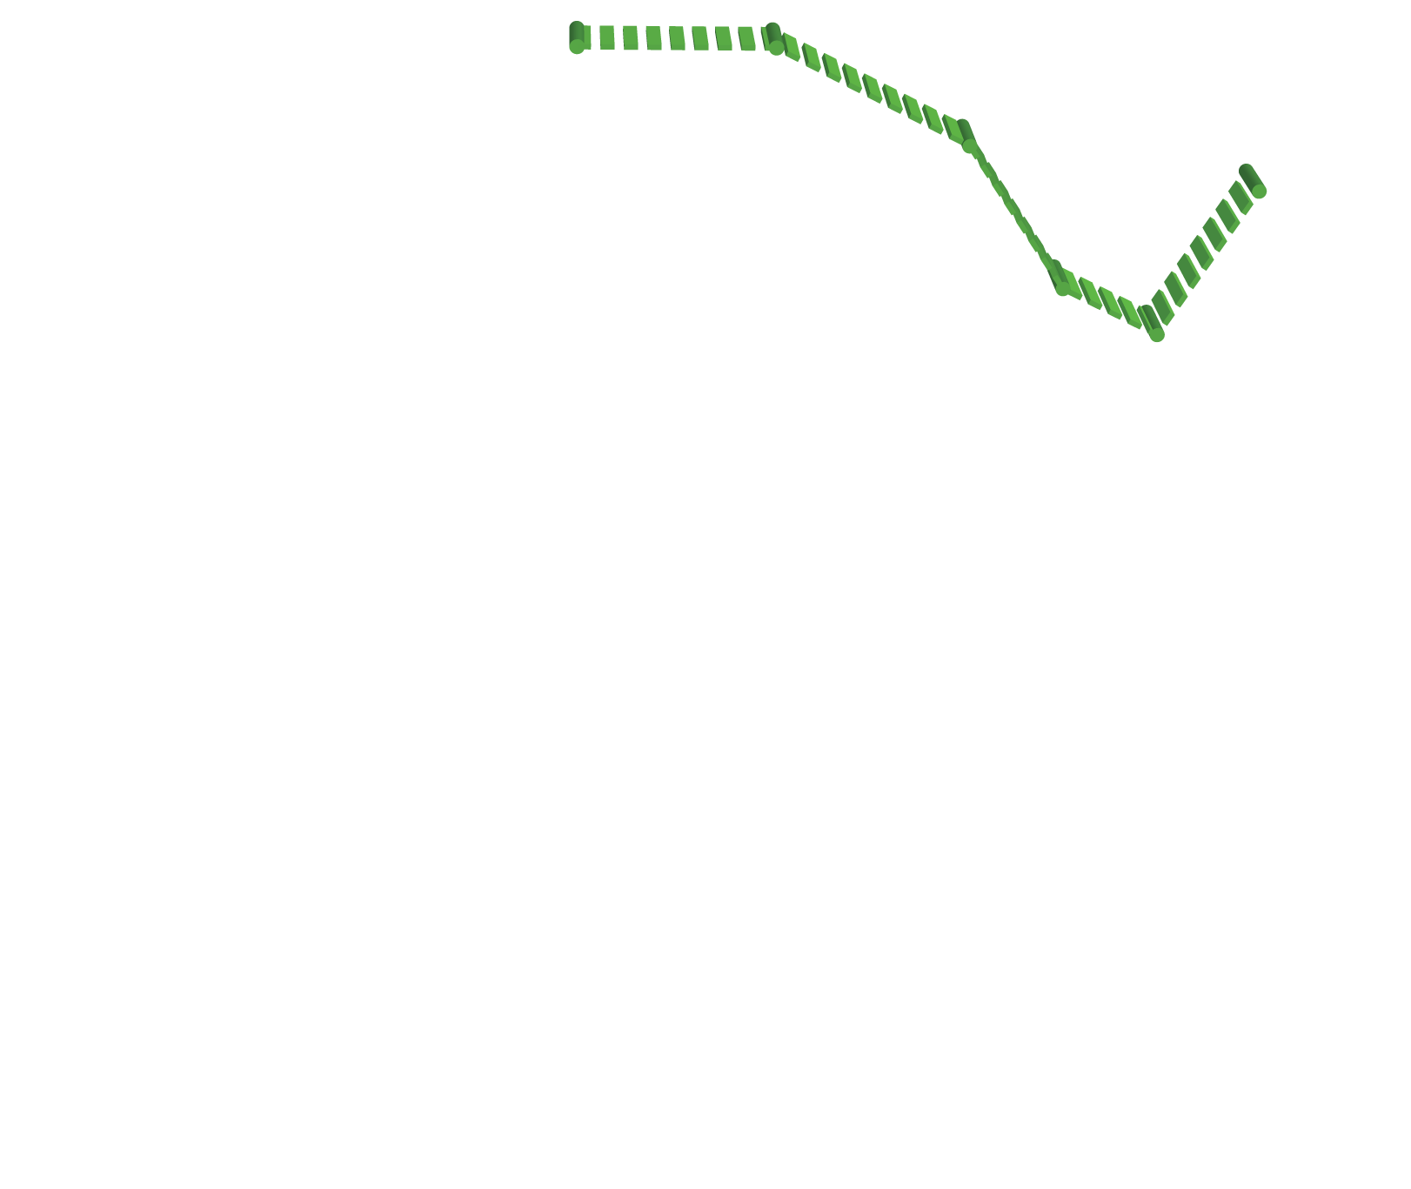





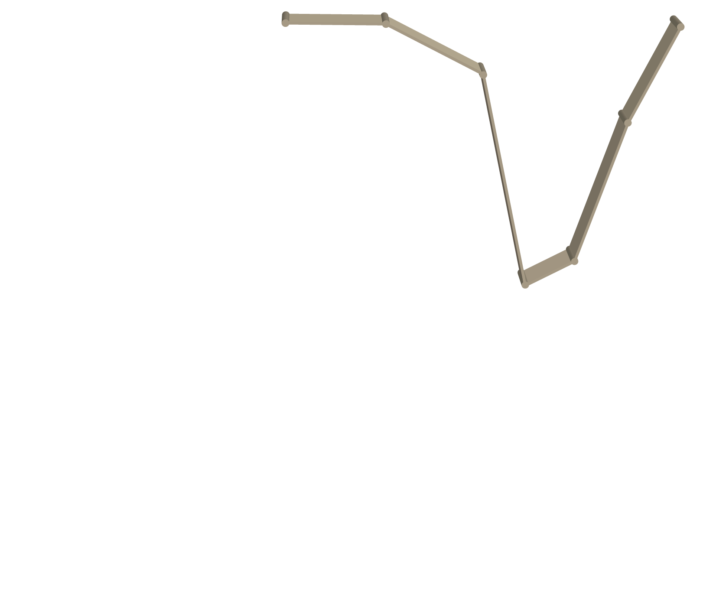
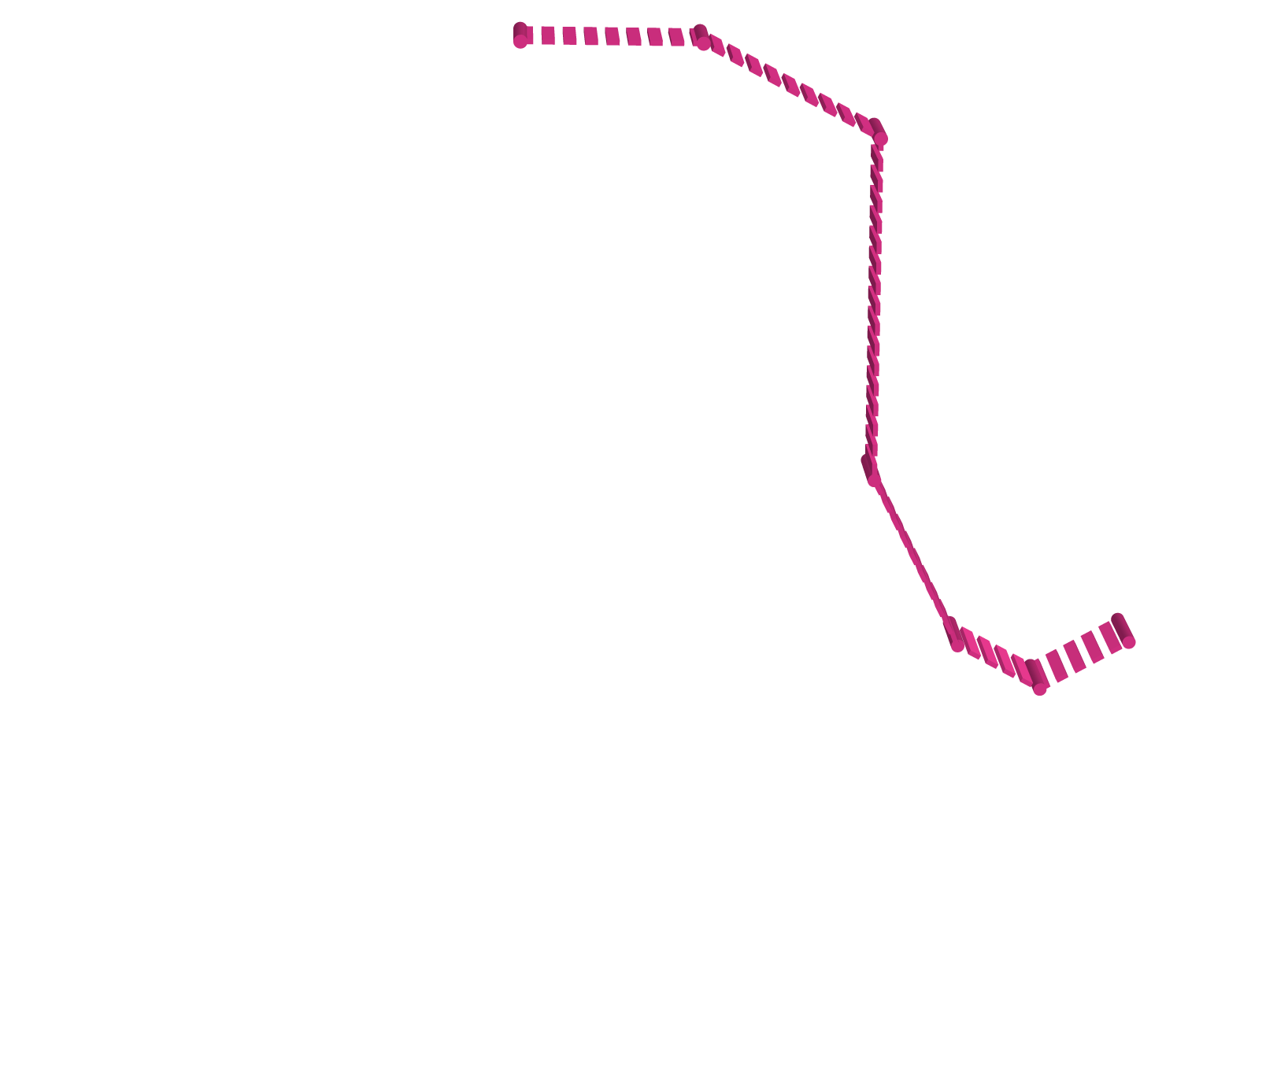
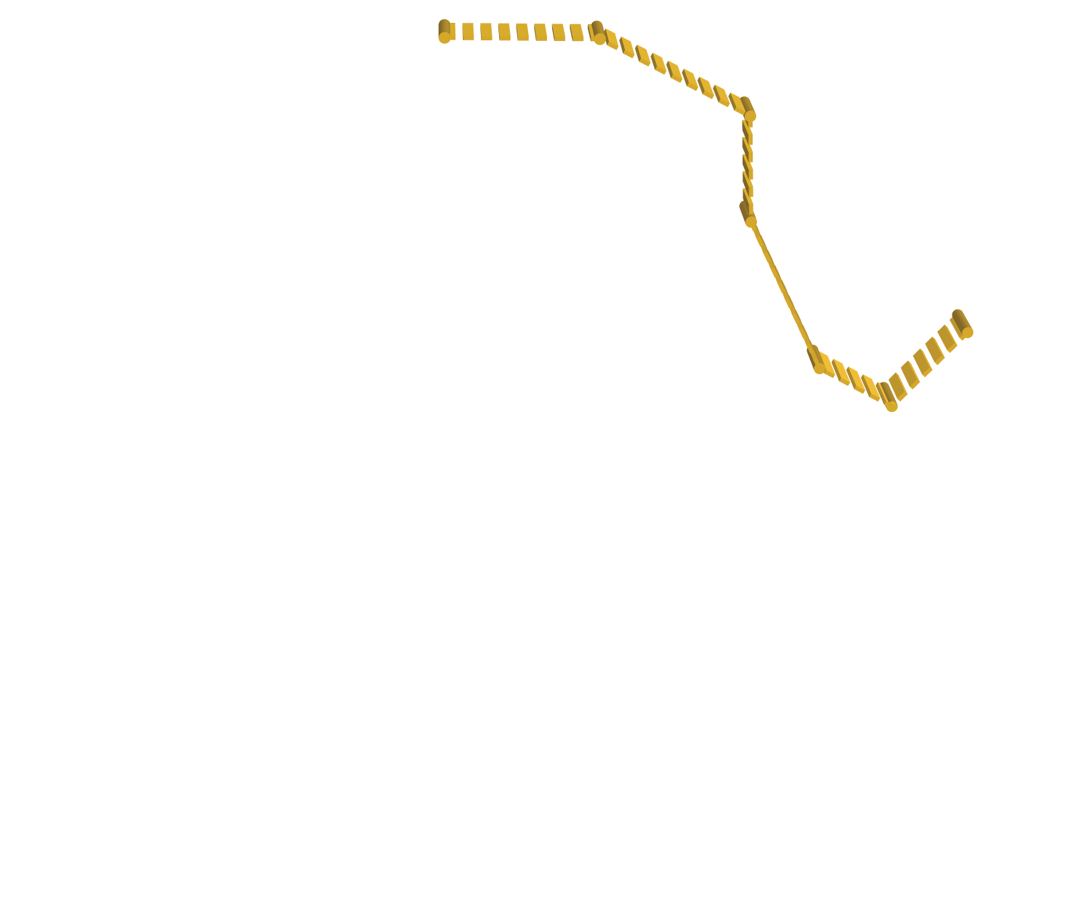
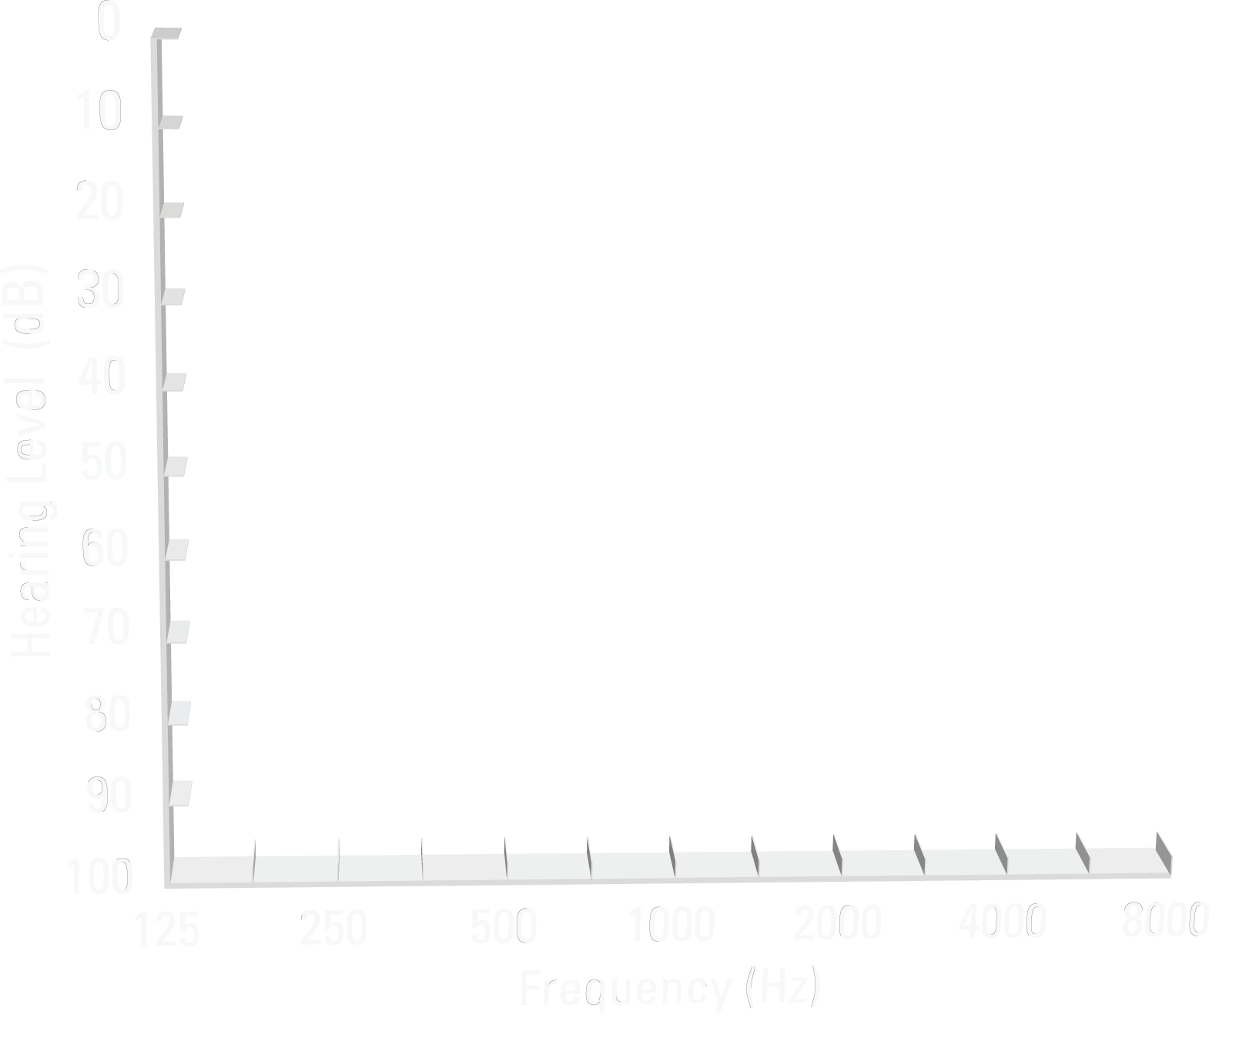
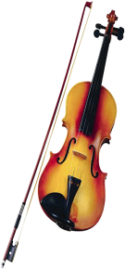


How Tough Are Your Ears?
Exposure Impacts People Differently
8+ Hours for 30 years at 100 dBA Ruben Gonzales CSO Condertmaster
Tough
Average
Weak
Susceptibility
Notes:
There are extensive tables called Damage Risk Criteria which predict the amount of hearing loss to be expected from different amount of noise or music exposure. From the dosimeter readings we had from Ruben, we concluded that his left ear probably had the equivalent of 100 dBA exposure for 8 hours a day for 30 years.
The prediction for “tough” ears is shown by the green curve. Someone falling within the 10% most resistant to hearing damage might have a 25 dB loss which would probably not have been noticeable. The prediction for “weak” ears, on the other hand, is shown by the purple curve at the bottom. Someone with the 10% least resistant ears would have a severe hearing loss a 3 and 4 kHz. 4 kHz is the top not on the piano, but also contains many of the harmonics of music and speech sounds such as /th/ and /f/ used in the words that and fun as “that was fun.” Not to mention /s/ which is the most important sound in making distinctions in English.
Ruben either had average toughness ears, or we overestimated his lifelong dosage since the time we measured him he was practicing to play the Brahms Violin Concerto which has a murdureous triple stop triple forte section in the middle.
The point is that even a violin can cause hearing damage, especially if it is a powerful Bergonzi and you play it with your ear down almost against it as Ruben did.
The other point is that there is no way to predict in advance how tough your ears are, and so it wouldn’t hurt to assume they were not tough. The cost of assuming they are tough when they aren’t is obvious.

Slide 30
Q: How can I tell how tough my ears are?
A: You can’t. The only safe thing to do is assume they are highly susceptible to hearing damage.
After nearly 100 years of scientific investigation, we still don’t know how to determine who can safely work on the deck of an aircraft carrier (with earplugs, of course) and which sailors should stay down below.
Notes:
There are extensive tables called Damage Risk Criteria which predict the amount of hearing loss to be expected from different amount of noise or music exposure. From the dosimeter readings we had from Ruben, we concluded that his left ear probably had the equivalent of 100 dBA exposure for 8 hours a day for 30 years.
The prediction for “tough” ears is shown by the green curve. Someone falling within the 10% most resistant to hearing damage might have a 25 dB loss which would probably not have been noticeable. The prediction for “weak” ears, on the other hand, is shown by the purple curve at the bottom. Someone with the 10% least resistant ears would have a severe hearing loss a 3 and 4 kHz. 4 kHz is the top not on the piano, but also contains many of the harmonics of music and speech sounds such as /th/ and /f/ used in the words that and fun as “that was fun.” Not to mention /s/ which is the most important sound in making distinctions in English.
Ruben either had average toughness ears, or we overestimated his lifelong dosage since the time we measured him he was practicing to play the Brahms Violin Concerto which has a murdureous triple stop triple forte section in the middle.
The point is that even a violin can cause hearing damage, especially if it is a powerful Bergonzi and you play it with your ear down almost against it as Ruben did.
The other point is that there is no way to predict in advance how tough your ears are, and so it wouldn’t hurt to assume they were not tough. The cost of assuming they are tough when they aren’t is obvious.

Slide 31
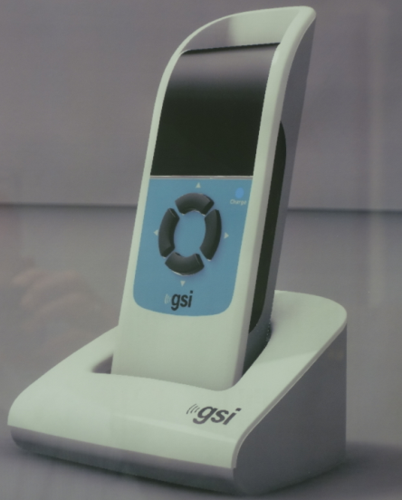
A good idea: Keep having your hearing checked! See an audiologist each year and have them measure your “DPOEs”
(Distortion Product Otoacoustic Emissions)
They will measure the strength of the
“Tartini Tone” coming out of your ear
(described 300 years ago by the famous violinist Giuseppe Tartini)

Slide 32
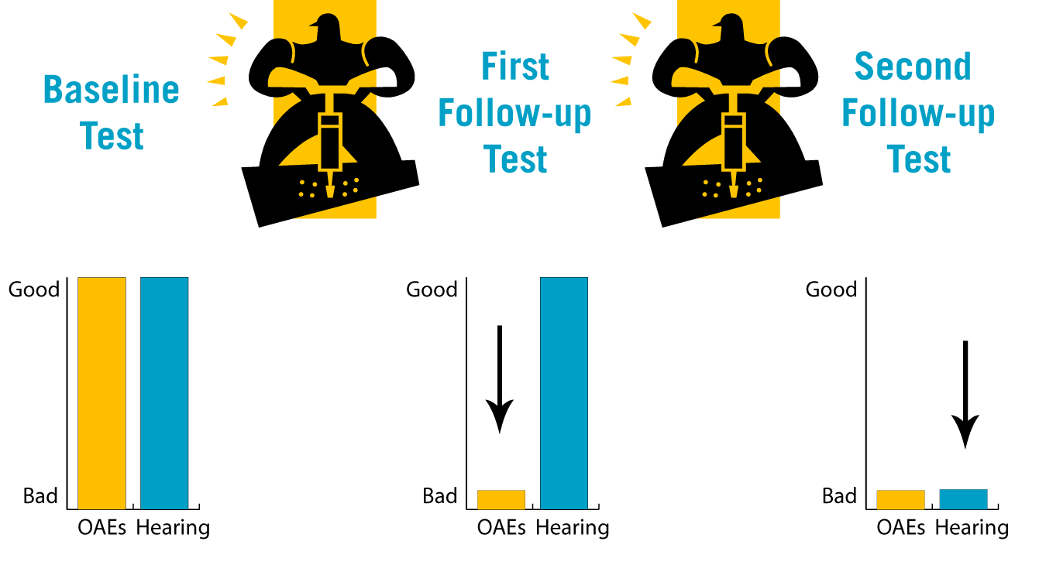
Tartini tones (DPOEs) may be like the canary in the mine
Background: Navy study by Lynn Marshall et al, 2011

Slide 33
Now a 2 minute “Quick SIN” (Speech In Noise) can give a great early warning.
See your Audiologist regularly! 0 dB “SNR loss” is normal. 10 dB is NOT
How Many Inner Hair Cells are You Missing?
A Quick Test: The Spoken Word vs. Background Noise
The sun came up to light the eastern sky.
5
5
5
?
?
?
25 dB SNR
20 dB SNR
15 dB SNR
10 dB SNR
5 dB SNR
0 dB SNR
The stale smell of old beer lingers.
The desk was firm on the shaky floor.
A list of names is carved around the base.
The news struck doubt into restless minds.
The sand drifts over the sill of the old house.
Total Score = _______ (normal = 25.5)
25.5 - Total Score = SNR loss (re normal)

Slide 34
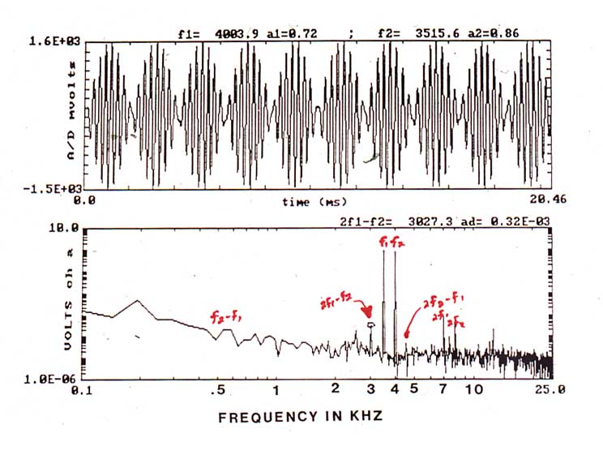
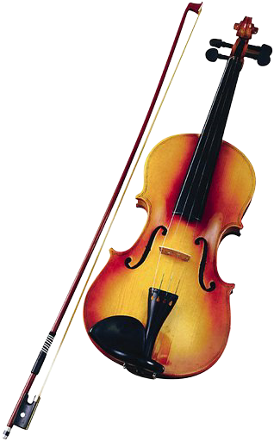
In additional to taking an audiogram, we can make objective measurement
to deduce the activity of the normal outer hair cells by detecting the intermodulation
distortion products that arrive back in the earcanal from the cochlea. What we measure
clinically is the “Tartini tone” he described in 1840 at the frequency 2f1-f2
G7 A8 B8
Notes:
research is increasing pointing to what we used to call old age deafness is actually a result of thousands of insults to the ears over the years. Of course our genetic makeup can have an impact, as do some drugs . . . there are dugs that can save your life but cause you to loose inner ear hair cells. But I belive what the research is showing us . . . that is that you have about 50,000 hair cells . . . if you lose only two hair cells a day, which is about 700 a year, in 20 years you’ll have no hair cells.
34

Slide 35
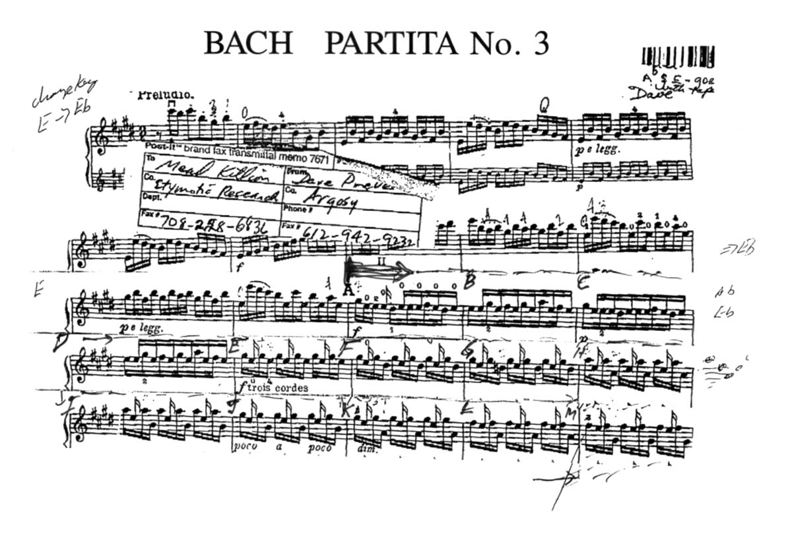
“BACH BY EAR”
PORTION OF MUSIC RECORDED FROM AN EAR IN REAL TIME
CD DEMONSTRATION

Slide 36
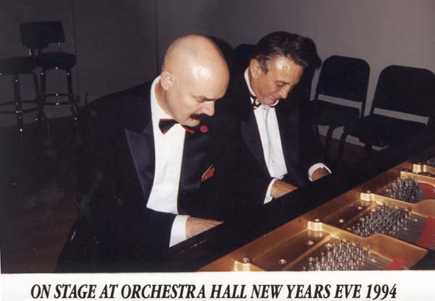
THE “TARTINI TONE BLUES”
The first and second notes are
the primaries, the third (bottom)
note is the Tartini tone.

Slide 37
How do I protect my ears in the first place?
(Repetition is sometimes the best teacher.)

Slide 38
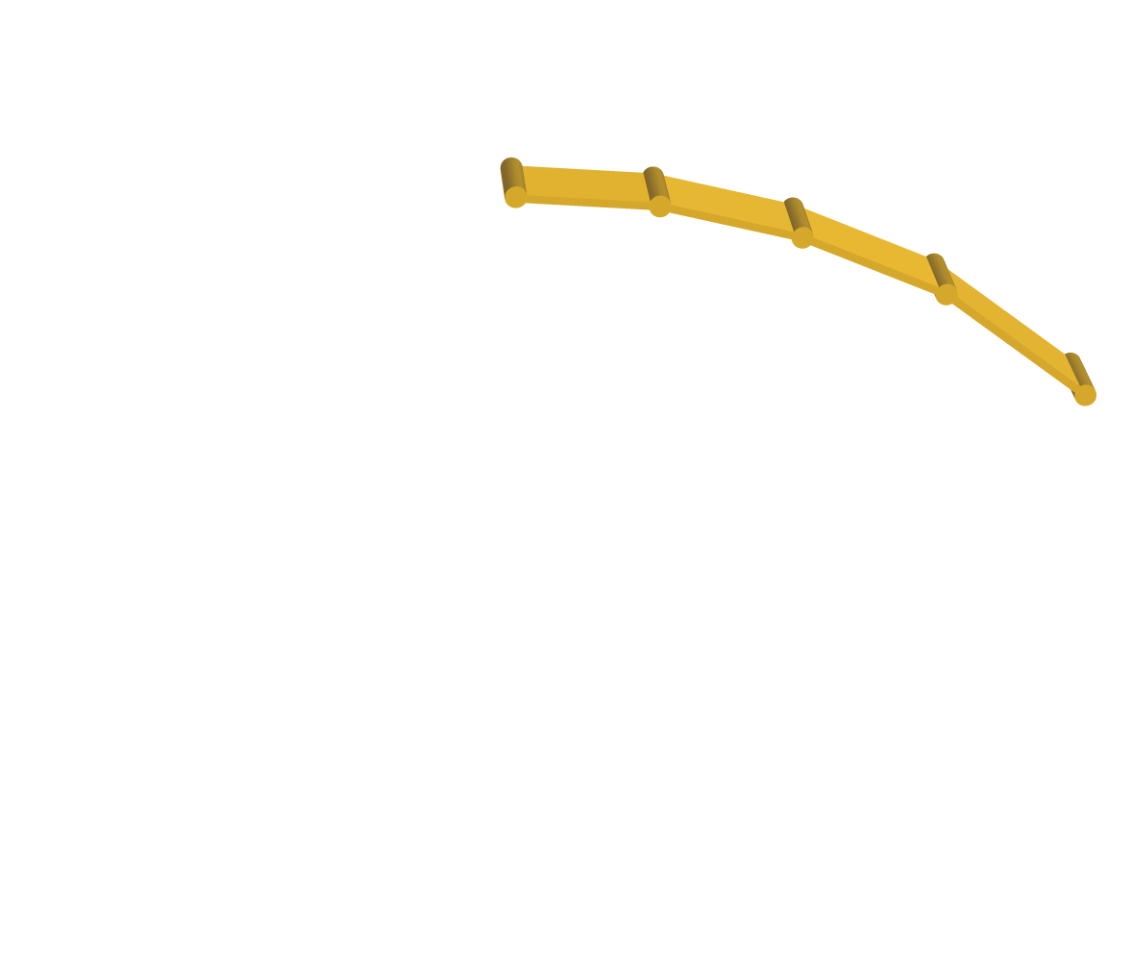
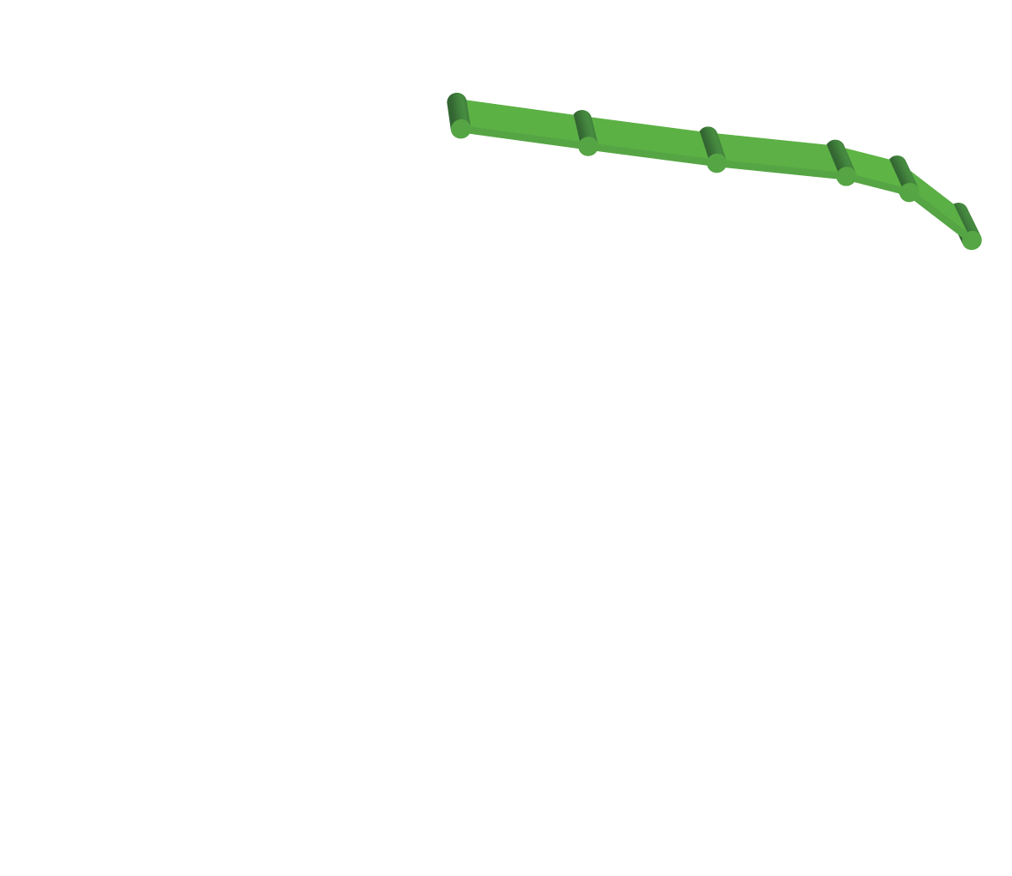
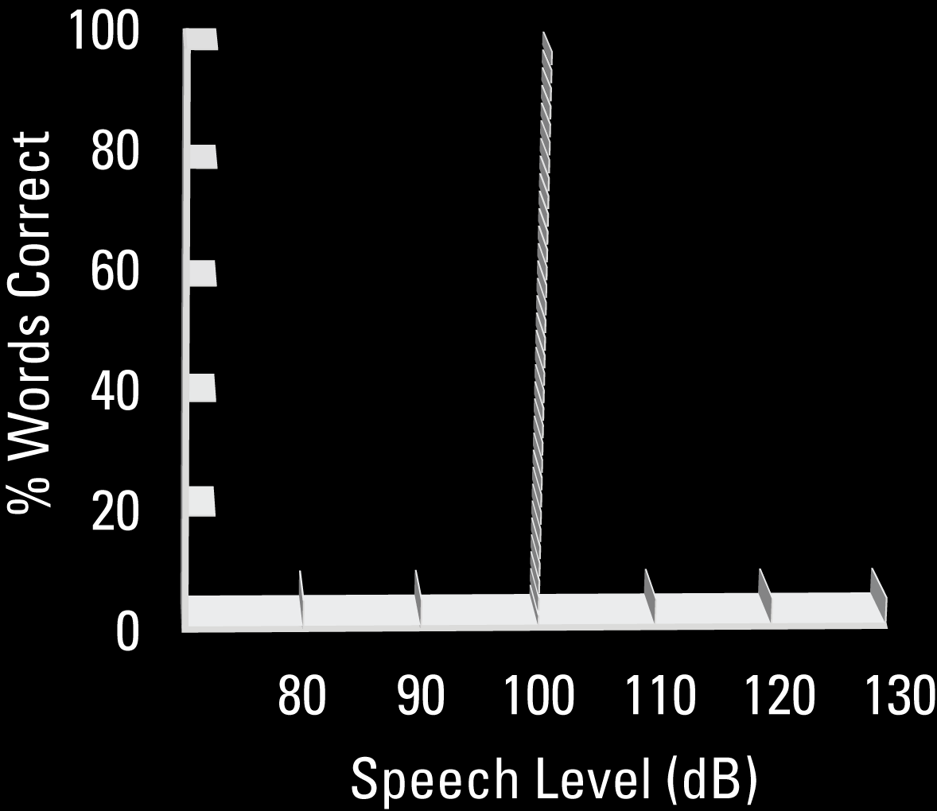
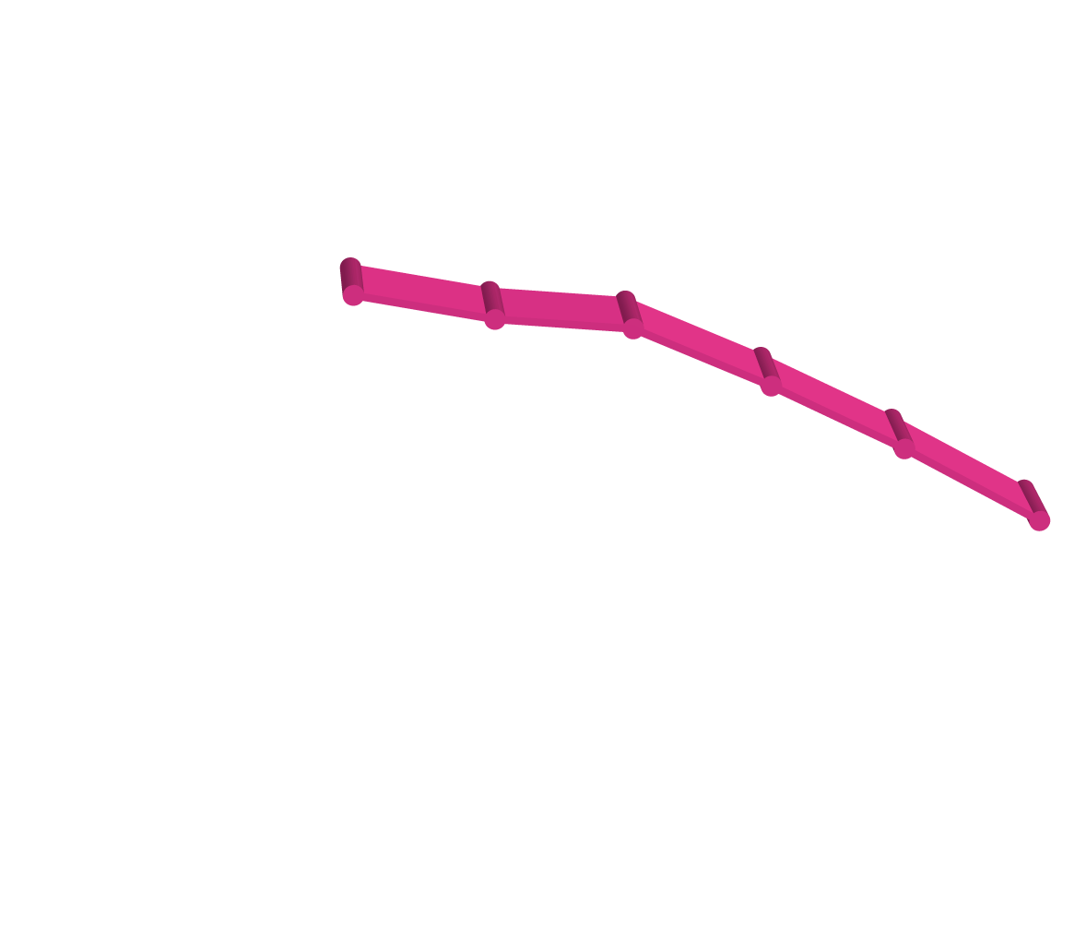
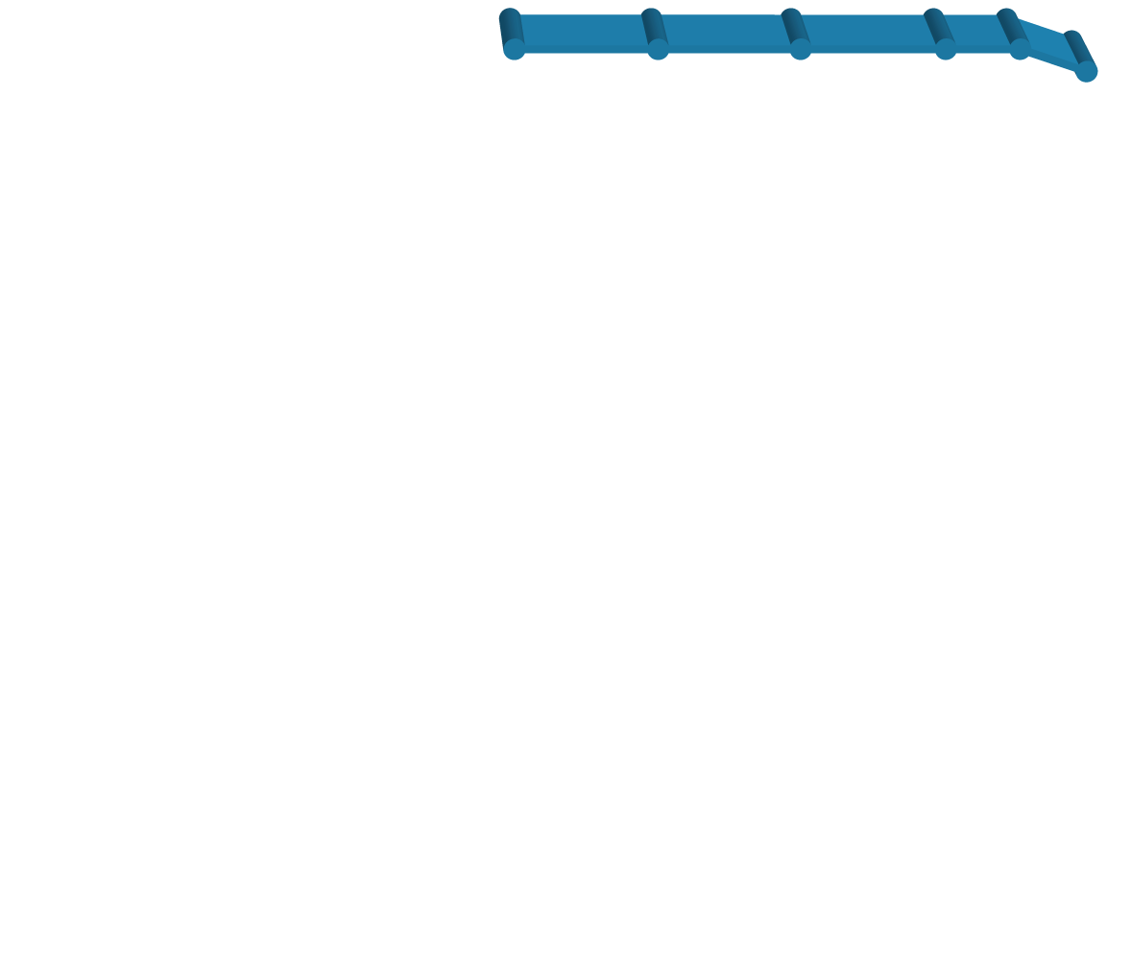

Earplugs Prevent Overload Distortion
Signal to noise ratio.
55dB
Intelligibility deteriorates above 100 dB
10dB
5dB
Same holds true for both music and speech
0dB
Notes:
In addition to the two musicians you heard on video, Pollack & Picket experiments in 1957 showed that your ear starts overloading above 100 dB SPL.
You’ve heard the comments of percussionists. Let me add those of a fiddle player who teaches, has played everything rom rock, bluegrass, C&W and was concertmaster of the Maui symphony. Even played with Willie Nelson a couple of times. She told me that when she plays out in front with a Country and Western band, she hears only a wall of sound. It is impossible for her to separate the players.
Once she started using ER-20 earplugs, she found that it was easy to hear the different instruments behind her. A comment not unlike the one we hear from the drummer who said that with earplugs he could hear the bells. “You can’t hear individual instruments or even your own voice when you sing with others.”
So one more reason for reducing the sound level in your ear is to hear more accurately. Hear better now and hear better later!
38

Slide 39
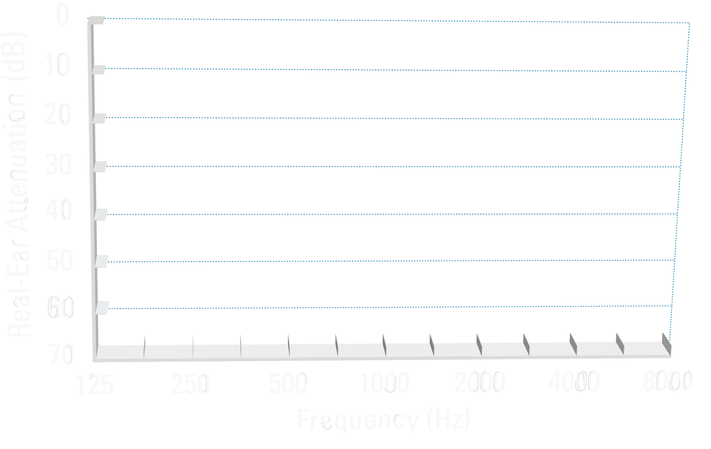
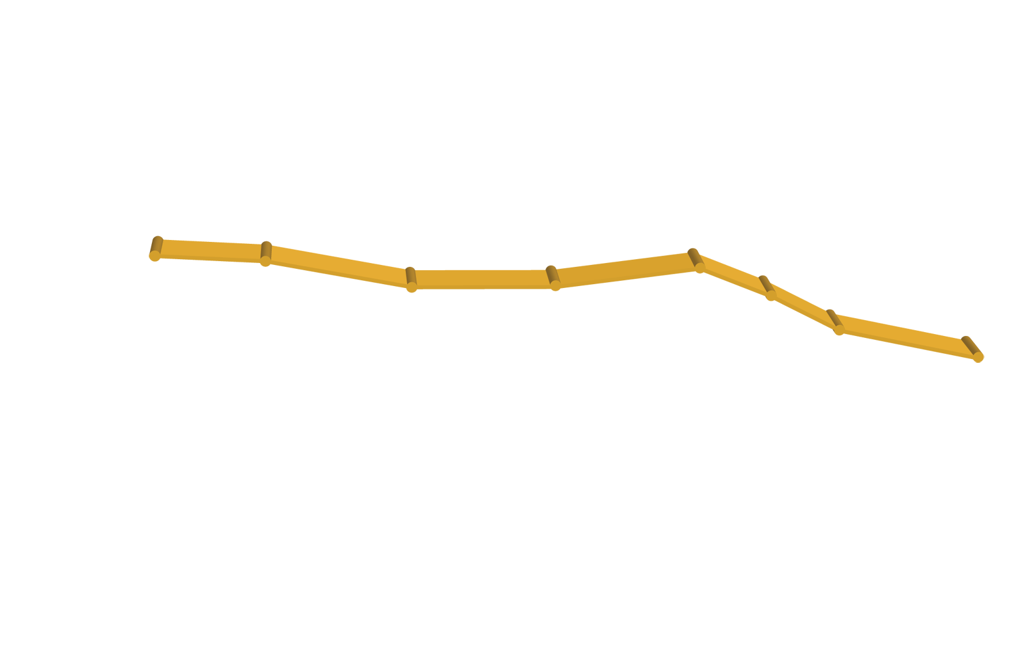
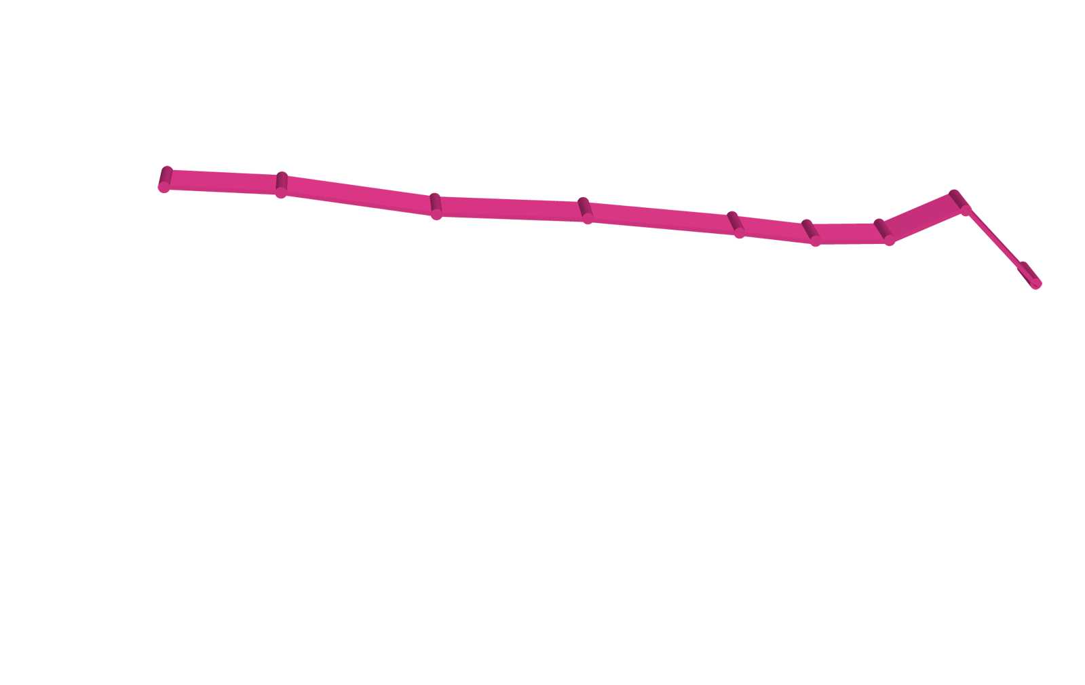
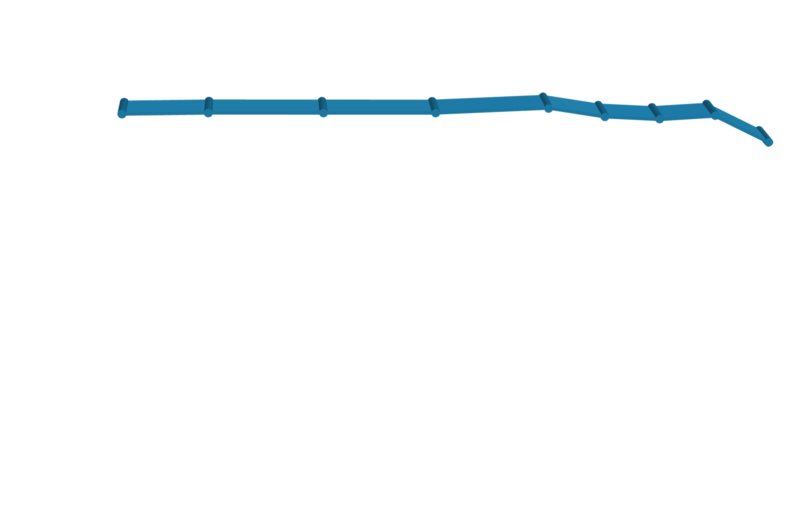

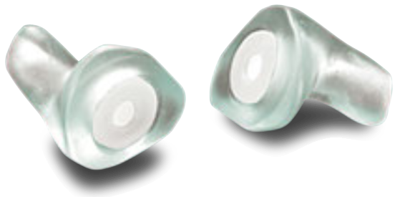
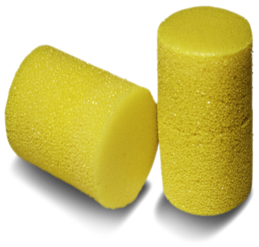
Do You Have Protection?
Musicians can accurately play with protection.
ER-9
ER-15
ER-25
Foam
Notes:
For more critical listening, the custom Musicians Earplugs are also available. The ER-15 version has a flat frequency response: within a dB or two from 80 Hz to 16 kHz.
Before I describe the more expensive premium hearing protection, let me say that Even the simplest foam earplugs will protect your hearing. Their disadvantage is that they muffle the sound. However, given the choice between preserving your hearing and sound quality I believe there is no choice. You can learn to play with foam. In fact, Gail and I often see a couple of CSO players put in yellow foam earplugs before a loud section of music. (One confessed to us: “I lost my Musicians Earplugs. I’ve got to get another pair.”)
But For critical listening, earplugs that have nearly a perfect frequency response are now available. They are available in three strengths:
The 15 dB plugs I already mentioned.
The viola players wanted less attenuation, so we introduced the 9 dB version shown in light green: Just as much high-frequency protection but only about 9 dB attenutaion up to 1000 Hz, which is two octaves above middle C and covers most of the viola sound unless you are playing up in the dust.
And several drummers told us the 15 dB earplugs were fine for jazz but not enough for their rock gigs. So we introduced the ER-25 earplugs that give about 25 dB of protection.
What does 24 dB of attenuation mean? It is safe to play at 112 dB LEQ sound level for only 1 minute. 60 seconds. With 24 dB of attenuation, you can safely play for 4.3 hours 8:00

Slide 40
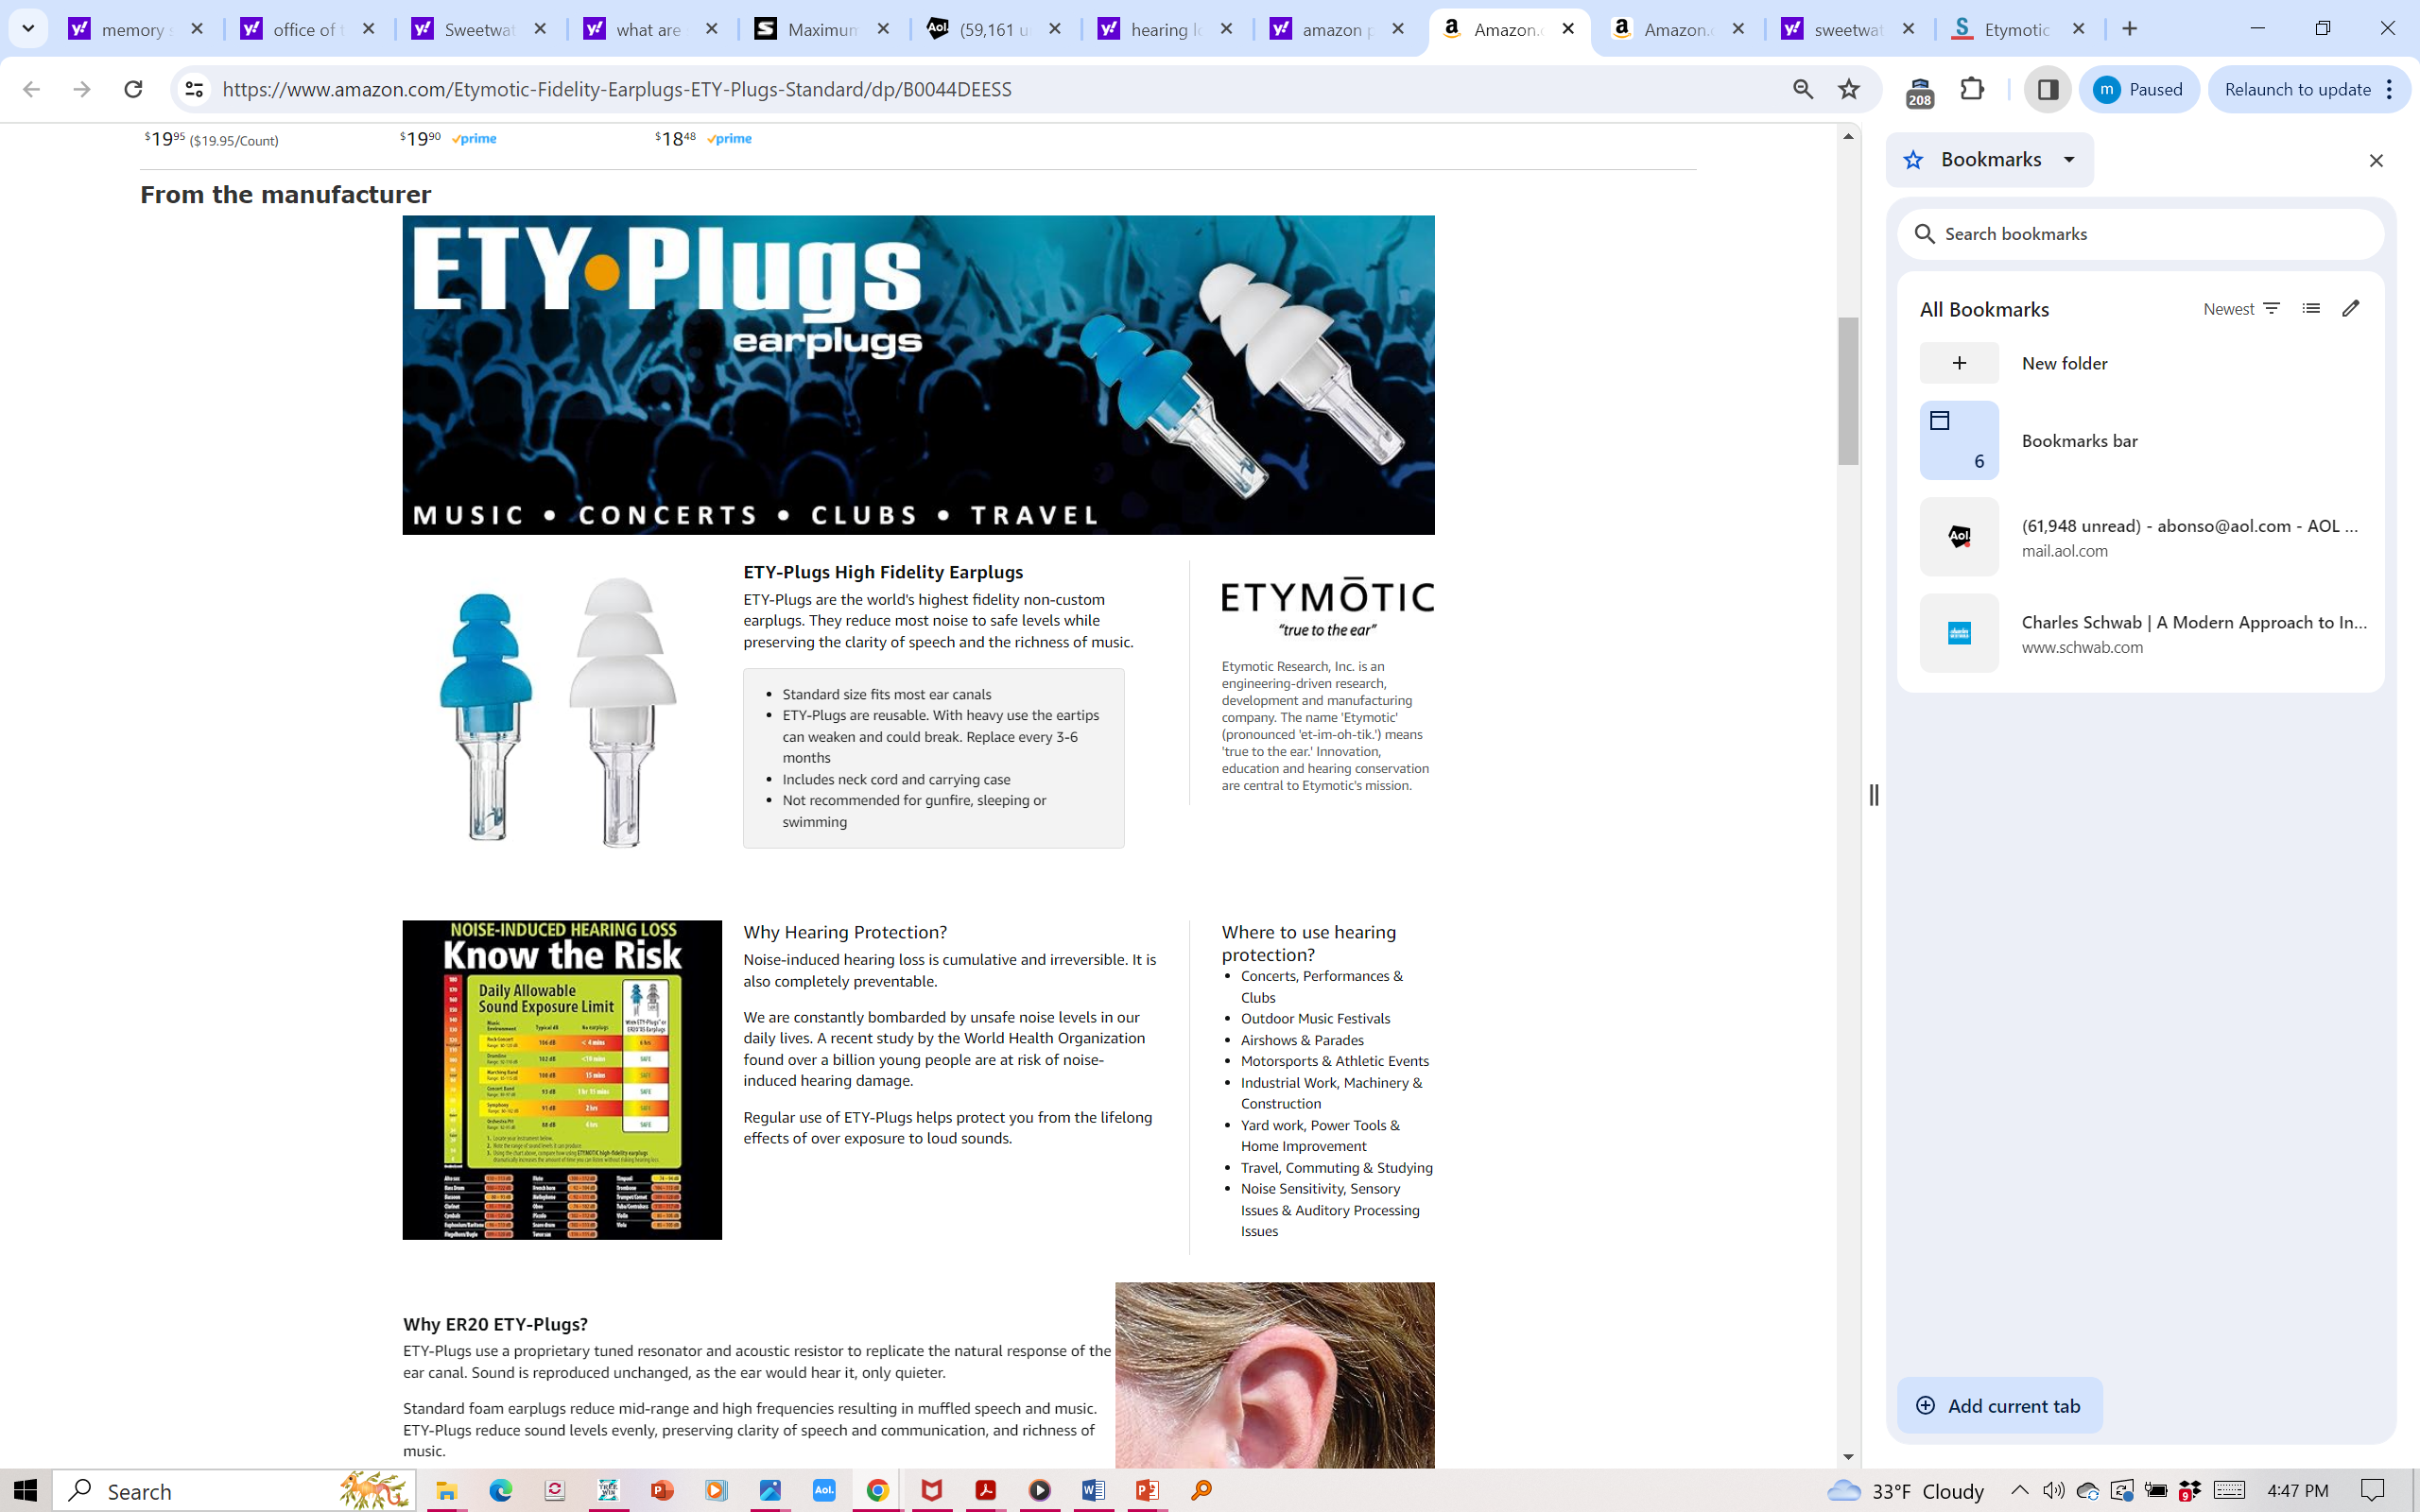
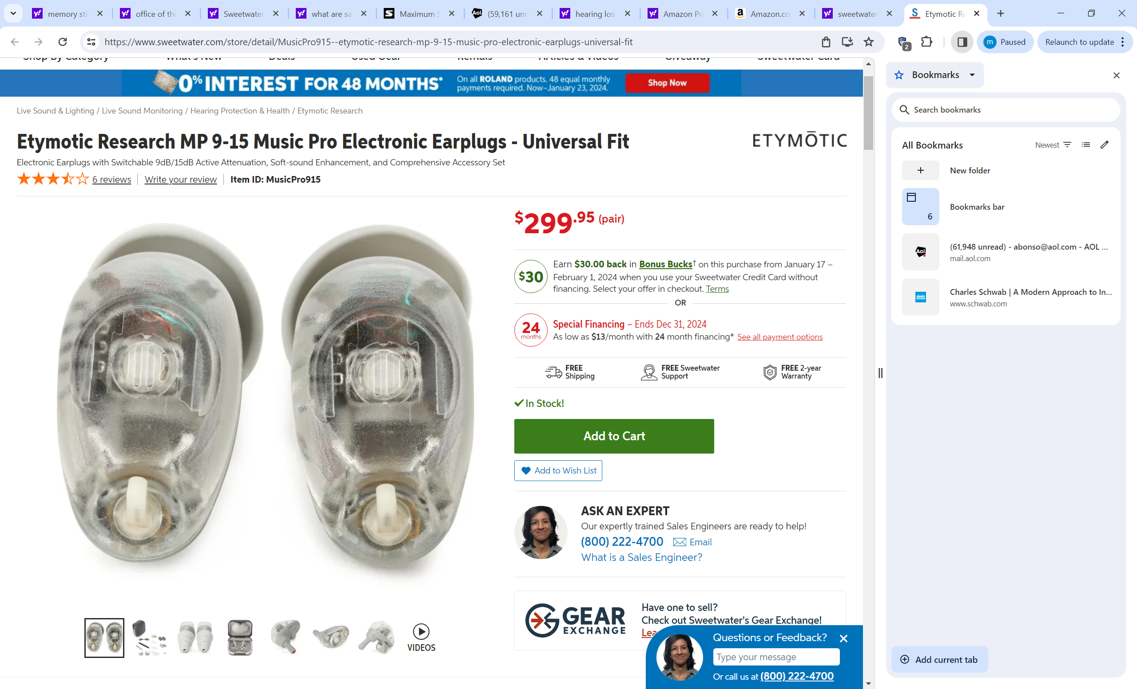
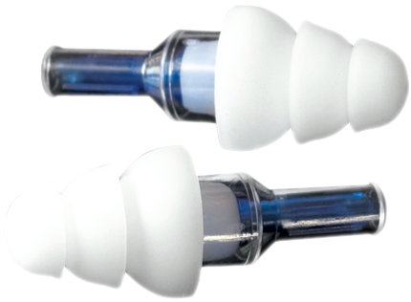
Play Safer Longer
Use of 20 dB earplugs will extend your safe playing time by a factor of 100
From 1 minute to 100 minutes, for example
ER-20 $20
Amazons
Music Pro 9-15 $299
Sweetwater Sound
800-222-4700 (260 432 8176
Ariana Bueno) if you can
get her. Great help.
Notes:
Today’s outline
1. Hearing loss is preventable
(We’ll talk about the different type of earplugs, any of which will preserve your hearing.)
(We’ll also mention a surprising fact: You can sometimes hear much more accurately with your ears plugged.)
2. We’ll talk a little about hearing loss and how we measure it
a. Hearing test audiogram – what it means
b. My brother and me: One has normal hearing
3. Why do so many musicians have music-induced hearing loss (when it is preventable)?
a. Rock musicians, band directors, classical musicians
b. WHY?
c. The critical role of the teacher and example setter
4. How we hear: Understanding audibility, problems in noise, pitch problems (Yehudi Menuhin)
a. The clicks
b. The tonotopic organization, the peak in the traveling wave at one frequency
c. Diplacusis, mead’s cartoon explanation
5. Safe listening time/level tables
dosimeter
What You Will Learn (CCP)
CUMULATIVE
Hearing Loss Is. Clock ticks with time and intensity. Pay now and pay later.
CONSEQUENCES
Moderate loss can affect the ability to hear the director’s direction
PREVENTABLE
Hearing loss is. And with little or no impact one’s ability to create, perform or enjoy music.

Slide 41
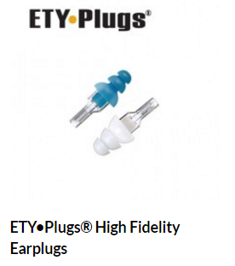
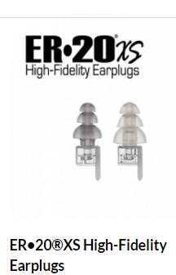
2.5 million pairs sold by 2018
Probably > 3 million by now

Slide 42
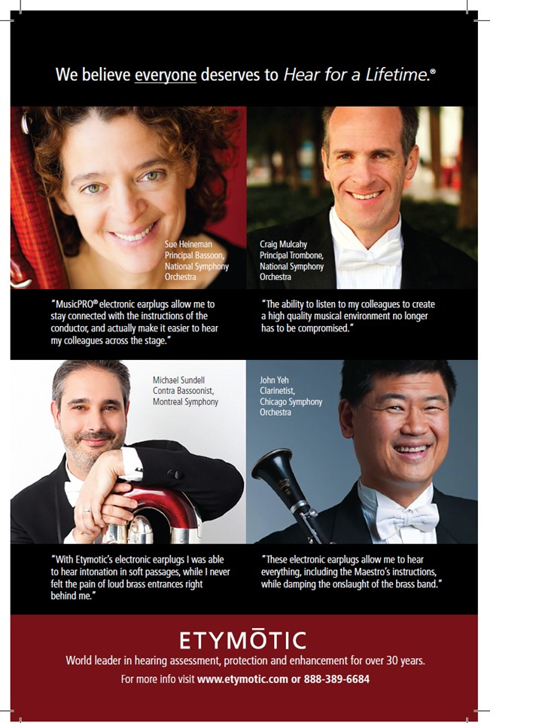
ETYMOTIC
MusicPro 9-15
electronic
earplugs
Set for 14 or 20 dB reduction for loud sounds, transparent for quiet sounds.
Rave reviews
from top orchestral
musicians.
Notes:
In addition to the two musicians you heard on video, Pollack & Picket experiments in 1957 showed that your ear starts overloading above 100 dB SPL.
You’ve heard the comments of percussionists. Let me add those of a fiddle player who teaches, has played everything rom rock, bluegrass, C&W and was concertmaster of the Maui symphony. Even played with Willie Nelson a couple of times. She told me that when she plays out in front with a Country and Western band, she hears only a wall of sound. It is impossible for her to separate the players.
Once she started using ER-20 earplugs, she found that it was easy to hear the different instruments behind her. A comment not unlike the one we hear from the drummer who said that with earplugs he could hear the bells. “You can’t hear individual instruments or even your own voice when you sing with others.”
So one more reason for reducing the sound level in your ear is to hear more accurately. Hear better now and hear better later!
42

Slide 43
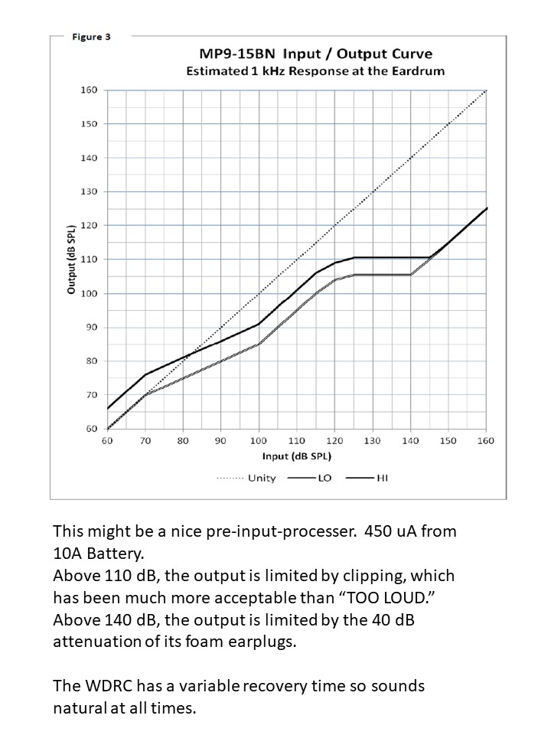
ETYMOTIC
MusicPro 9-15
electronic
earplugs
Set for 10 or 14 dB reduction for moderately loud sounds, additional for sounds above 110 dB,
Rave reviews
from top orchestral
musicians.
Notes:
In addition to the two musicians you heard on video, Pollack & Picket experiments in 1957 showed that your ear starts overloading above 100 dB SPL.
You’ve heard the comments of percussionists. Let me add those of a fiddle player who teaches, has played everything rom rock, bluegrass, C&W and was concertmaster of the Maui symphony. Even played with Willie Nelson a couple of times. She told me that when she plays out in front with a Country and Western band, she hears only a wall of sound. It is impossible for her to separate the players.
Once she started using ER-20 earplugs, she found that it was easy to hear the different instruments behind her. A comment not unlike the one we hear from the drummer who said that with earplugs he could hear the bells. “You can’t hear individual instruments or even your own voice when you sing with others.”
So one more reason for reducing the sound level in your ear is to hear more accurately. Hear better now and hear better later!
43

Slide 44

Another hint for successful
use of earplugs: Make sure you get a deep seal in the earcanal.
“My own voice sounds hollow” and
“My trombone sounds louder in my ear with earplugs in”
“That is called the Occlusion Effect.”
It goes away with an earmold having a deep seal beyond the second bend.➔

Slide 45
Can trumpet players use HPDs?
Notes:
Today’s outline
1. Hearing loss is preventable
(We’ll talk about the different type of earplugs, any of which will preserve your hearing.)
(We’ll also mention a surprising fact: You can sometimes hear much more accurately with your ears plugged.)
2. We’ll talk a little about hearing loss and how we measure it
a. Hearing test audiogram – what it means
b. My brother and me: One has normal hearing
3. Why do so many musicians have music-induced hearing loss (when it is preventable)?
a. Rock musicians, band directors, classical musicians
b. WHY?
c. The critical role of the teacher and example setter
4. How we hear: Understanding audibility, problems in noise, pitch problems (Yehudi Menuhin)
a. The clicks
b. The tonotopic organization, the peak in the traveling wave at one frequency
c. Diplacusis, mead’s cartoon explanation
5. Safe listening time/level tables
dosimeter
What You Will Learn (CCP)
CUMULATIVE
Hearing Loss Is. Clock ticks with time and intensity. Pay now and pay later.
CONSEQUENCES
Moderate loss can affect the ability to hear the director’s direction
PREVENTABLE
Hearing loss is. And with little or no impact one’s ability to create, perform or enjoy music.

Slide 46
Can real musicians use HPDs?
Yes: I myself can play trumpet just as badly with earplugs in as with open ears. Smile
Although much better after lessons from Leah Schuman!
Notes:
Today’s outline
1. Hearing loss is preventable
(We’ll talk about the different type of earplugs, any of which will preserve your hearing.)
(We’ll also mention a surprising fact: You can sometimes hear much more accurately with your ears plugged.)
2. We’ll talk a little about hearing loss and how we measure it
a. Hearing test audiogram – what it means
b. My brother and me: One has normal hearing
3. Why do so many musicians have music-induced hearing loss (when it is preventable)?
a. Rock musicians, band directors, classical musicians
b. WHY?
c. The critical role of the teacher and example setter
4. How we hear: Understanding audibility, problems in noise, pitch problems (Yehudi Menuhin)
a. The clicks
b. The tonotopic organization, the peak in the traveling wave at one frequency
c. Diplacusis, mead’s cartoon explanation
5. Safe listening time/level tables
dosimeter
What You Will Learn (CCP)
CUMULATIVE
Hearing Loss Is. Clock ticks with time and intensity. Pay now and pay later.
CONSEQUENCES
Moderate loss can affect the ability to hear the director’s direction
PREVENTABLE
Hearing loss is. And with little or no impact one’s ability to create, perform or enjoy music.

Slide 47
The final experiment is perhaps the most important one:
Experiments with the UCLA jazz band and a University of Indiana Orchestra Ensemble found that recordings made with MusicPRO earplugs in place could not be told apart from recordings made with open ears.
This was true for both types of listening judges:
a. Experienced Musicians, and
b. Non-musician Listeners.
It was also true (no detectable difference in audience sound) despite the fact that the Ensemble Musicians said they preferred playing without earplugs (they had only 10 hours experience).
The members of the jazz band had no complaints, smile.

Slide 48

Summary
You Can Have Teenage Ears When You're Older
Protect yourself from excessive noise exposure as you would from excessive
UV exposure
Broken bones heal, ears do not
The critical element in reducing hearing loss is the awareness amongst teachers -- and students– not the earplug
Edge, U2
That’s you!!

Slide 49
End of formal presentation
Questions?

Slide 53

Back in his 70s he had played the Bach Double with Isaac Stern at a NY Philharmonic Gala

Slide 54


Slide 55


